Slide 1


Slide 2

This presentation is for informational purposes only and is not intended as legal advice or an offer of legal representation.

Slide 3
THIS PRESENTATION WILL COVER:
•Where to file complaints
•School obligations to students under state and federal laws
•FERPA (Family Education Rights and Privacy Act of 1974)
•Students’ rights under the 4th, 5th, and 6th Amendments

Slide 4
ABOUT THE ACLU OF MINNESOTA
For over 70 years in Minnesota, the ACLU has worked in courts, legislatures, and communities to protect the constitutional and individual rights of all people. With a nationwide network of offices and millions of members and supporters, we take on the toughest civil liberties fights. Beyond one person, party, or side—we the people dare to create a more perfect union.

Slide 5
WE'RE IN THIS TOGETHER
We know you love your students and may be worried about them based on recent developments around immigration and LGBTQ+ identity.
This presentation is intended to provide Minnesota educators with an overview of how to serve their students.

Slide 6
WHERE TO FILE COMPLAINTS
With the Minnesota Department of Human Rights: mn.gov/mdhr/intake/consultationinquiryform/
With us at the ACLU of Minnesota: intake.aclu-mn.org/

Slide 7
SCHOOLS' KEY RESPONSIBILITIES TO STUDENTS AND FAMILIES
Ensure fair and non-discriminatory treatment. (MHRA, Minn. Const. Art. I, Plyler v. Doe, Title IV and VI of the Civil Rights Act, Title IX, 14th Amendment.)
Protect the privacy of students and families. (MGDPA, FERPA.)
Protect students’ constitutional rights with respect to law enforcement. (4th, 5th, and 6th Amendments.)
Ensure school is free of harassment and bullying. (MHRA, Safe and Supportive Minnesota Schools Act, Title IV, VI, and Title IX, Minn. Const. Art. 1, 14th Amendment.)
Administrators' responsibilities extend to overseeing the activities of all persons working in a school and directly with students and parents.

Slide 8
RIGHTS OF MINNESOTA STUDENTS UNDER STATE LAW
“Education is a fundamental right under the [Minnesota] state constitution, not only because of its overall importance to the state but also because of the explicit language used to describe this constitutional mandate.” Skeen v. State, 505 N.W.2d 299, 313 (Minn. 1993).
The Minnesota Human Rights Act protects students from discrimination and harassment based on their race, religion, national origin, sex, sexual orientation, and gender identity. All Minnesota students are entitled full access to any school. Minn. Stat. § 363A.13.
The Safe and Supportive Minnesota Schools Act prohibits bullying and harassment based on race, ethnicity, color, religion, national origin, immigration status, sex, sexual orientation, and gender identity. Minn. Stat. § 121A.031.

Slide 9
SCHOOLS ARE AUTHORIZED AND OBLIGATED TO PROTECT STUDENTS FROM IMMIGRANT FAMILIES
Taken together, state and federal law gives the school the authority and the obligation to protect the rights of all students to a public K-12 education free from discrimination and bullying, and regardless of the immigration status of any student or their family.
Main rule: School policies that chill or limit participation of, or exclude altogether, students based on their or their parents' or guardians' actual or perceived immigration status are unconstitutional and unlawful.

Slide 10
BEST PRACTICES TO PROTECT IMMIGRANT STUDENTS
DOs
DON'Ts
Review your policies on what information you collect from students and families. If there is no reason to collect it, don’t.
Educate students and families about their rights—it is okay to talk to students about fears and concerns in an age-appropriate manner.
Don’t inquire into immigration status when determining residency or age.
Don’t require documents for determining residency or age that only people with current immigration status can have (e.g., passport, social security number, etc.).
Don’t treat students or families differently based on race, religion, national origin, citizenship, immigration status, etc.

Slide 11
Don’t Inquire into Immigration Status when Determining Residency or Age
Enrollment: Proof of Residency
In order to ensure that its educational services are enjoyed only by residents of a school district, the district may require students or their parents provide proof of residency within the district. See e.g., Martinex v. Bynum, 461 U.S. 321, 328 (1983)
However, inquiries into a student’s or parent’s immigration status are not allowed because they are not relevant to residency.

Slide 12
RIGHTS OF MINNESOTA STUDENTS UNDER FEDERAL LAW
Titles IV and VI of the Civil Rights Act of 1964 prohibit discrimination based on race, color, or national origin, among other factors, by public elementary and secondary schools, and other (private) schools and programs that accept federal funding.
Title IX prohibits sex discrimination, which courts have recognized to include sex stereotyping, sexual orientation, and gender identity. See, e.g., Grimm v. Gloucester Cty. Sch. Bd., 972 F.3d 586 (4th Cir. 2020); Bostock v. Clayton Cty, 590 U.S. 644 (2020) (Title VII).
Schools have the common law responsibility to care for children in place of their parents while children are at school.
In Plyler v. Doe, 457 U.S. 202 (1982), the U.S. Supreme Court held that a state may not deny access to public K-12 education to any child residing in the state, whether present in the U.S. with or without current immigration status.

Slide 13
Don’t Inquire into Immigration Status when Determining Residency or Age
Enrollment: Proof of Age
School districts may require that students show they fall within State-mandated minimum and maximum age requirements and may accept a variety of documents for that purpose.
Birth certificates are most common. A school district cannot bar a student from enrolling because her birth certificate indicates a foreign place of birth or the student cannot produce a birth certificate.
However, inquiries into a student’s or parent’s immigration status are not allowed because they are not relevant to age.

Slide 14
BEST PRACTICES TO PROTECT THE RIGHTS OF IMMIGRANT STUDENTS – FERPA
Family Education and Privacy Act of 1974
FERPA generally prohibits schools and school districts that receive federal funds from releasing personal information contained in a student’s education records without the written consent of the parent or adult (18+) student.
This also includes most private schools.
"Personal information" does not include directory information, such as name and address.
However, releasing directory information for purposes of immigration enforcement would be in violation of Plyler v. Doe and other laws.
FERPA requires schools and school districts to maintain a record, wFERPA also requires schools and school districts to maintain a record, within the student's record, of all individuals, agencies, and organizations that have requested the student's personal information.
FERPA has several exceptions – 2 are very important when it comes to law enforcement, including ICE.
Exception for a subpoena.
Exception for "school officials."

Slide 15
FERPA "DIRECTORY INFORMATION" CONSIDERATIONS
Directory information might include name, address, telephone number, date of birth, place of birth, etc.
FERPA allows disclosure of directory information without consent, but only if it gives annual public notice of the types of information which it has designated as "directory information," the parent's or eligible student's right to restrict the disclosure of such information (opt-out), and the period of time within which a parent or eligible student has to notify the school in writing that he or she does not want any or all of those types of information designated as "directory information." Nothing requires disclosure.
However, if a school or school district is asked to release directory information for purposes of immigration enforcement, a school cannot release it, as doing so would conflict with Plyler v. Doe and other laws.
Nonetheless, schools and school districts should create policies that limit what information is considered directory information.

Slide 16
FERPA COURT ORDER/SUBPOENA EXCEPTION
FERPA allows a law enforcement officer to obtain personal information from a school if they have a valid court order or judicial subpoena.
If a law enforcement officer presents you with a court order or a subpoena, you should alert the Superintendent and the school district's attorney before taking any actions.
Superintendents, make sure you speak with the school district's attorney to make sure that the court order or subpoena is valid. The attorney may also be able to quash (determine invalid and unenforceable) a seemingly valid subpoena.
School district attorneys, you are required to make a "reasonable effort to notify the parent... of the subpoena in advance of compliance."
Note: An "ICE subpoena" is not a valid judicial subpoena. Schools may not honor them.
If you must give out personal information due to this exception, you must also alert the affected family unless the subpoena explicitly states that you may not.
You may not release personal information if the subpoena is invalid.

Slide 17
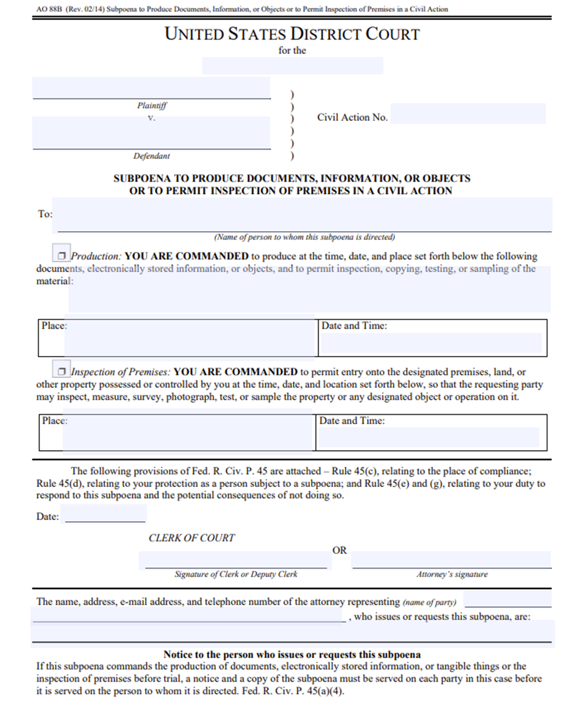


EXAMPLE OF A VALID SUBPOENA
A valid judicial subpoena requires:
Judge or Federal Court clerk's signature.
The target of the subpoena (in this case FERPA information).
The address of the target of the subpoena (the school).
Administrative subpoenas are not valid judicial warrants. (e.g., "Immigration Enforcement subpoena").

Slide 18
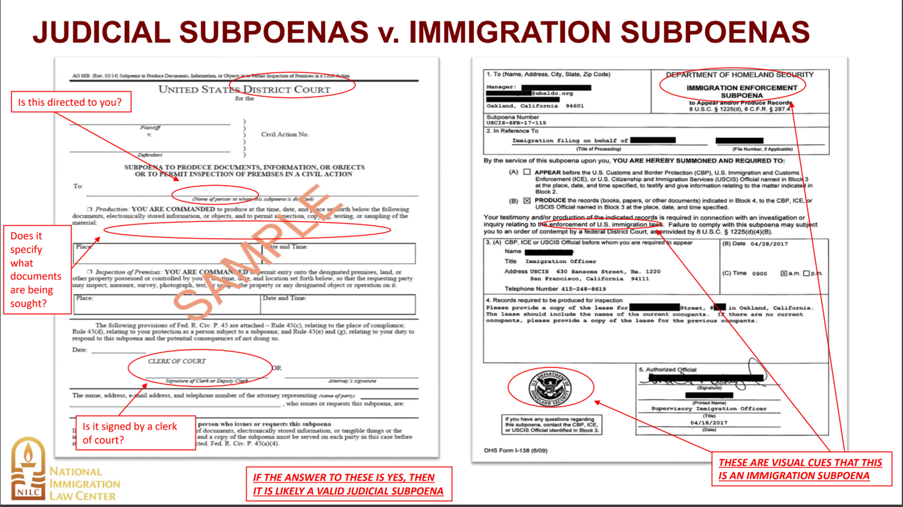

Slide 19
FERPA "SCHOOL OFFICIALS" EXCEPTION
FERPA allows "school officials" and outside entities performing an "institutional service or function" to obtain personal information from a student's file.
This exception requires: (1) the school official is under direct control of the school at all times; (2) limiting access as needed to fulfill a “legitimate educational interest”; and (3) limiting use and redisclosure to original purpose.
It is possible that a school might invoke this exception for police officers performing some "institutional service or function" for the school. If that is the case, the info cannot be redisclosed (or shared) to law enforcement for a law enforcement investigation.
Remember, administrators' responsibilities extend to overseeing the activities of all persons working in a school and directly with students and parents.

Slide 20
BEST PRACTICES TO PROTECT THE RIGHTS OF IMMIGRANT STUDENTS – FERPA RECAP
FERPA generally prevents schools from disclosing personal information from a student's file without written parental consent.
FERPA makes an exception for valid court orders and subpoenas.
Reminder: "Immigration and Enforcement subpoenas" do not fall under this exception.
FERPA makes an exception for "school officials," which can sometimes include law enforcement officers.
Reminder: 1. the school must retain direct control of the information at all times, 2. the information must be limited to fulfill a "legitimate educational interest," and 3. the use and redisclosure must be limited to the original purpose.
Escalate any seemingly valid law enforcement request for information to the Superintendent and the school district's attorney before any action is taken.
Superintendents and attorneys, you are required to protect students' information. You may only give it out if it falls under a valid exception. Failure to do so may be a violation of FERPA, Plyler v. Doe, Title IV, Title VI, and/or common law.
And remember, you can't disclose what you don't collect.

Slide 21
BEST PRACTICES TO PROTECT THE RIGHTS OF IMMIGRANT STUDENTS – FERPA SUGGESTIONS
Review your school's/district's policy regarding collection of personal data. What data do you really need to know? What data is considered directory information? What data could be used against your students and their families if it were learned? Do any of your current policies have a chilling effect on enrollment and/or attendance?
Escalate any requests for FERPA information to the Superintendent and the school district's attorney. If ICE doesn't have a valid reason to be on school grounds, you are able to ask them to leave. Some school districts have had success calling the police to force ICE to leave.
Superintendents and attorneys, you are required to make sure all FERPA requests fall under a valid exception. Be prepared to recognize what a valid subpoena looks like, have policies in place to make sure "school officials" are always under direct control of the school, and the information is only used for its educational purpose.

Slide 22
BEST PRACTICES TO PROTECT THE RIGHTS OF IMMIGRANT STUDENTS
Have a protocol in place if ICE were to come to your school
Ensure ICE officials report to the front office (clearly mark outdoor areas as being closed to the public during school hours)
Front office staff should direct ICE officials to wait and immediately contact an identified point person (superintendent, school principal, etc.), who should then consult with the district’s attorney
Train all teachers and staff on your district’s protocol
Any actions by ICE agents should be observed and documented. Schools should make copies of officers’ identification documents, as well as any warrants or subpoenas

Slide 23
A BRIEF KNOW-YOUR-RIGHTS WHEN INTERACTING WITH LAW ENFORCEMENT
Regardless of a student's (or parent's) immigration or citizenship status, they have constitutional rights.
Students have the right to remain silent. If a student wishes to exercise that right, they should say so out loud.
Students have the right to refuse to consent to a search of themselves, their backpack, their locker, their car, etc.
If a student is not under arrest, they have the right to calmly remove themselves from the officer's presence.
A student has the right to a lawyer if they are put in law enforcement custody, including interrogations at school. They should ask for one immediately.

Slide 24
A BRIEF KNOW-YOUR-RESPONSIBILITIES WHEN INTERACTING WITH LAW ENFORCEMENT
Students should stay calm and be polite.
Students can assert all of their legal rights, but should not lie or give false names or documents.
Students and families can prepare themselves just in case they do have an encounter with law enforcement.
Students should remember the details of the encounter, including officer names and badge numbers, if possible.

Slide 25
FOURTH AMENDMENT
If a law enforcement officer approaches you and tells you they need, want to talk to, or otherwise request a student, you have an obligation to protect the student's rights. Ask the officer for the legal basis of their request and immediately escalate the request to the Superintendent and the school district's attorney.
In other words, you have a legal responsibility to protect your students, not to immediately comply with any law enforcement request.
School Resource Officers and school-based police, they are "law enforcement officers" for the purposes of the 4th Amendment, even if they serve other functions within a school.

Slide 26
INTERROGATION VS. SEARCHES AND SEIZURES
The 4th amendment protects all people from unreasonable searches and seizures by the government, including ICE and CBP.
Law enforcement officers need a valid judicial warrant to search or seize a student or their belongings.
An "ICE warrant" is not a valid judicial warrant under the fourth amendment.
If a law enforcement officer requests to search or seize (arrest) a student or their belongings, you should demand a warrant and elevate any warrants to the Superintendent and the school district's attorney.
The 4th Amendment also protects students from police interrogations while at school. Police need reasonable suspicion that a crime has been committed or will be committed to interrogate a student in school, but nothing requires schools to allow them to interrogate a student.

Slide 27
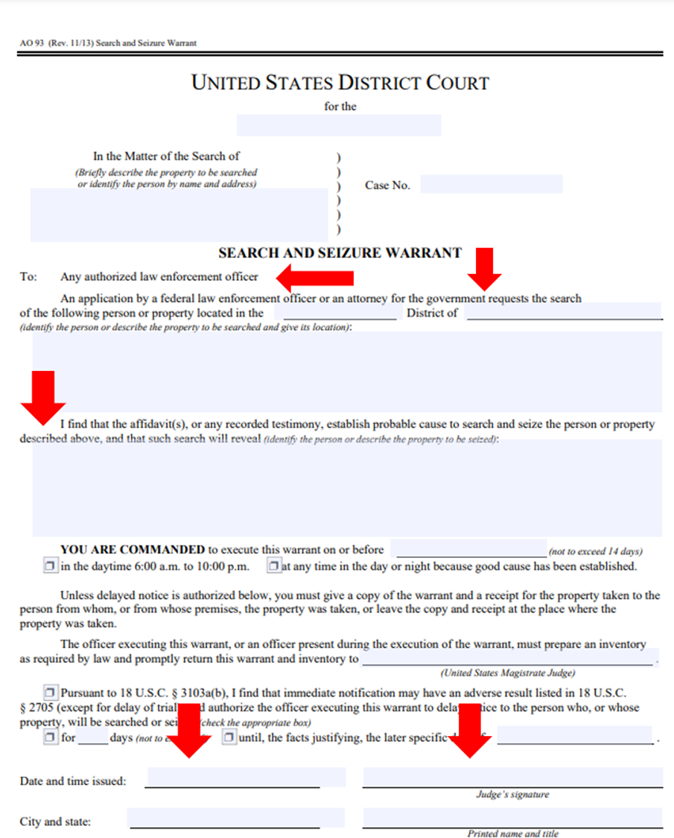
EXAMPLE OF A VALID WARRANT
A valid judicial search warrant requires:
The judge's name and signature
The person's name and address
The date (not expired)
The name of the agency conducting the search or arrest
A search warrant also requires:
A description of any items being searched
Administrative subpoenas are not valid judicial search warrants. (e.g. "ICE warrant").

Slide 28
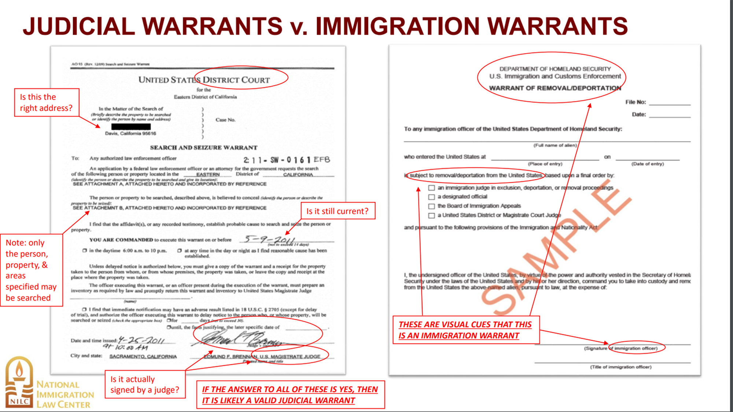

Slide 29
FIFTH AND SIXTH AMENDMENTS
If a student is being taken into custody by a law enforcement officer, they have the right to remain silent, and the right to an attorney.
"custody“ does not necessarily mean arrest – it means being put in a situation in which a person does not think they are allowed to leave, including interrogations.
Students can and should utilize these rights, and school officials must help them understand and protect their rights and not undermine them in any way.
You may open yourself up to lawsuits if you do not protect your students' 4th, 5th, and 6th Amendment rights.

Slide 30
FOURTH, FIFTH AND SIXTH AMENDMENT SUGGESTIONS
Escalate any law enforcement requests for students to the Superintendent and the school district's attorney. If ICE doesn't have a valid reason to be on school grounds, you are able to ask them to leave. Some school districts have had success calling the police to force ICE to leave.
Warrants are necessary for law enforcement officers to access any nonpublic areas. Revisit your school's/district's policy on what parts of the school are nonpublic. Maintain these standards for everyone and have clear demarcations.
Revisit school policies on what to do when a law enforcement officer asks to search or seize a student or their belongings, or when they ask to interrogate a student. Do you have policies in place that requires a parent or guardian to be present during an interrogation? Do you have policies in place to deny any requests to interrogate at school?
Superintendents and attorneys, you are required to make sure all law enforcement requests to search or seize students or their belongings are accompanied by a valid judicial search warrant. Be prepared to recognize what a judicial search warrant looks like, and have policies in place to make sure your school is helping students understand and enforce their constitutional rights.

Slide 31
PROTECT IMMIGRANT STUDENTS – FINAL RECAP
Main rule: It is illegal to create a policy position that would chill the enrollment and attendance of students based on protected characteristics, including immigration status.
FERPA protects students' personal information. Do not give it out unless it falls under a valid exception. You must verify that the exception is valid, and you must support your students' rights.
All students have constitutional rights, which you must help them understand and utilize. Make sure you understand the nature of all warrants, court orders, and subpoenas, and make sure to help your students use their right to remain silent and right to an attorney for custodial interrogations and arrests.
And remember, you can't disclose what you don't collect.

Slide 32
SCHOOLS ARE AUTHORIZED AND OBLIGATED TO PROTECT TRANSGENDER STUDENTS UNDER MINNESOTA LAW
DO ensure that transgender students use the same restrooms and locker rooms as other students, consistent with students’ gender identity. N.H. v. Anoka-Hennepin Sch. Dist. No. 11, 950 N.W.2d 553 (Minn. Ct. App. 2020); MHRA; Minn. Const. Art. 1 § 2.
DO allow transgender students to participate in school activities and on teams in a way that aligns with their gender identity. MHRA; Minn. Const. Art. 1 § 2; Minnesota State High School League 300.03, 2024-2025 MSHSL Official Handbook.

Slide 33
SCHOOLS ARE AUTHORIZED AND OBLIGATED TO PROTECT TRANSGENDER STUDENTS UNDER MINNESOTA LAW
DO protect LGBTQ+ students from bullying and harassment.
DO respect students’ names and pronouns.
DO allow students to express their support for the LGBTQ+ community and dress consistent with their gender identity.
DO have students self-report their gender identity.
DO treat LGBTQ+ student groups (GSA, Pride Alliance) similarly to other student groups.
DO NOT remove books from your library shelves simply because they include LGBTQ+ characters and stories.
MHRA; Safe and Supportive Schools Act; Minn. Const. Art. 1 § 2 & 3; Minn. Stat. 134.51.

Slide 34
SCHOOLS ARE AUTHORIZED AND OBLIGATED TO PROTECT LGBTQ+ STUDENTS' PRIVACY
Students have the right to ask that a school keep their sexual orientation and gender identity private.
A student’s gender identity and pronouns are private, and are not directory information under FERPA and the Minnesota Government Data Practices Act.
Casual use of a student’s incorrect pronoun or incorrect name, revealing the student’s transgender status, may violate FERPA and MGDPA.
Disclosure of private information regarding a student’s transgender status could amount to harassment and discrimination under the Minnesota Human Rights Act and Minn. Const. Art. 1 § 2.
FERPA requires schools and school districts to maintain a record, within the student's record, of all individuals, agencies, and organizations that have requested the student's personal information.
FERPA makes an exception for "school officials": 1. the school must retain direct control of the information at all times, 2. the information must be limited to fulfill a "legitimate educational interest," and 3. the use and redisclosure must be limited to the original purpose.

Slide 35
RESOURCES
The Department of Education has a Student Privacy Policy Office (SPPO) that specializes in student privacy and FERPA: ed.gov/about/ed-offices/opepd/student-privacy-policy-office (https://perma.cc/8Y5X-8AFV).
Guidance letter from the DoE and DoJ on school obligations under Plyler v. Doe and other federal laws: justice.gov/sites/default/files/crt/legacy/2014/05/08/plylerletter.pdf (https://perma.cc/48BG-P2KH) and accompanying FAQ: justice.gov/sites/default/files/crt/legacy/2014/05/08/plylerqa.pdf (https://perma.cc/B46E-J32H).
DoE FAQs on student privacy: studentprivacy.ed.gov/frequently-asked-questions (https://perma.cc/3E6D-VMVX).
National Immigration Law Center guidance on warrants and subpoenas in the immigration context: nilc.org/wp-content/uploads/2020/09/Warrants-Subpoenas-Facts.pdf (https://perma.cc/KG3J-GE6A).
Organizations like ACLU-MN are here to support however possible.

Slide 36


