Slide 1
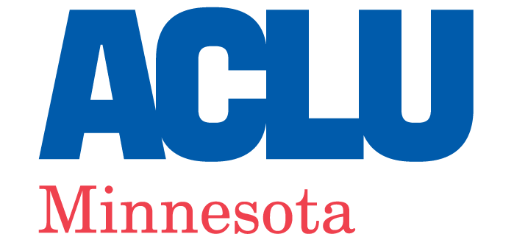
Back To School
Know Your Student’s Rights Virtual Town Hall
October 9, 2025
Notes:
START by 8:02pm Eastern.

Slide 2
Know Your Student’s Rights
Panelists:
Nikki Kruse-Dye
Teresa Nelson | tnelson@aclu-mn.org
Catherine Ahlin-Halverson | cahlin@aclu-mn.org
Julio Zelaya | jzelaya@aclu-mn.org

Slide 3

Agenda
I. How a book ban in my children's school turned me into an organizer. Nikki Kruse-Dye
II. Know students’ First Amendment rights. Teresa Nelson
III. Know LGBTQ+ students’ rights. Catherine Ahlin-Halverson
IV. Know immigrant and BIPOC students’ rights. Teresa Nelson
V. Trends on extremist school boards and legal
protections against them.
Catherine Ahlin-Halverson
VI. What can you do? Join School Board Watch.
Julio Zelaya

Slide 4
Know Your Student’s Rights
This presentation is for informational purposes only and is not intended as legal advice or an offer of legal representation.

Slide 5

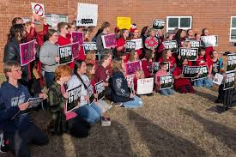
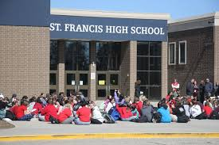
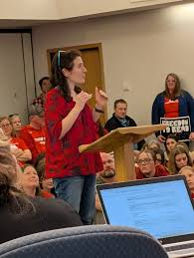

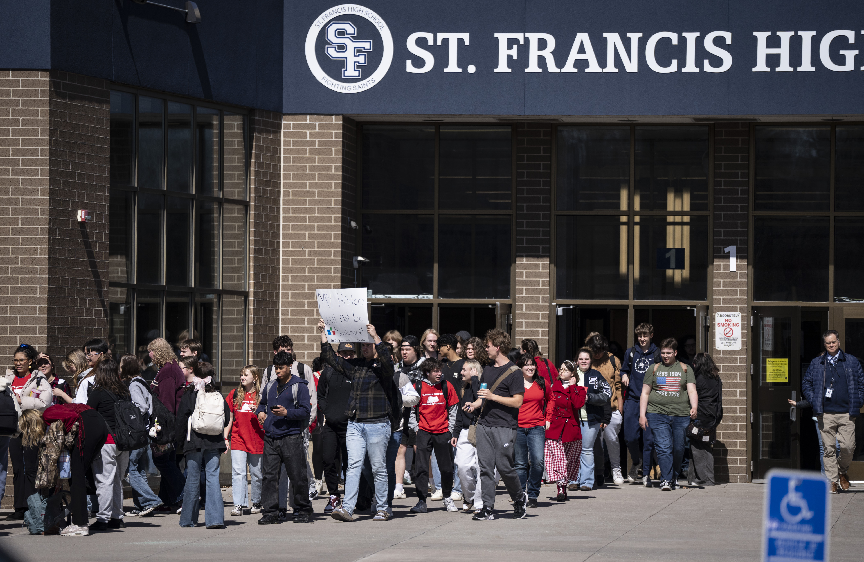
St. Francis Book Ban – Nikki Kruse-Dye

Slide 6
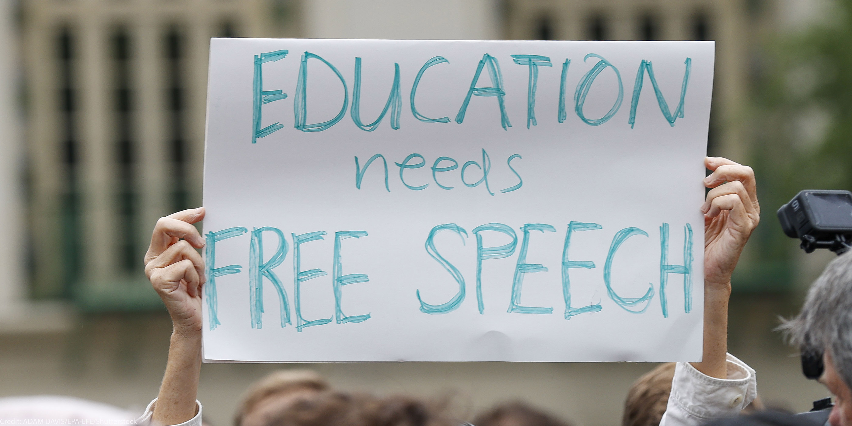
Know Your Student’s First Amendment Rights

Slide 7
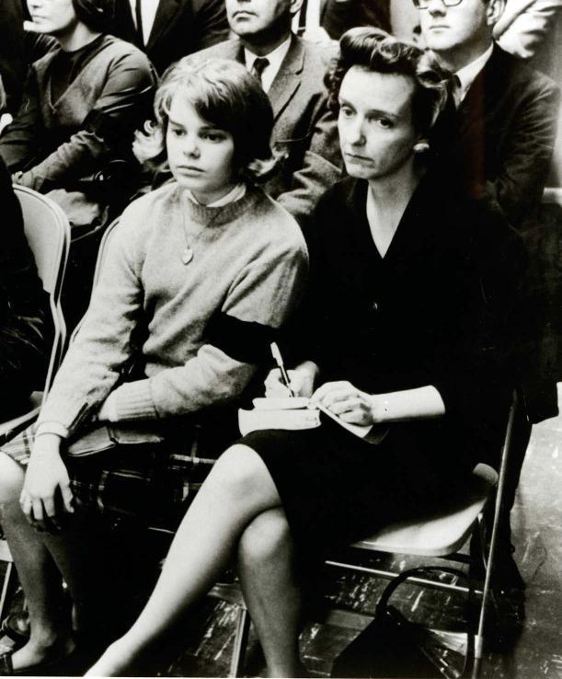
Know Your Student’s First Amendment Rights
Students don’t “shed their constitutional rights to freedom of speech or expression at the schoolhouse gate.”
Tinker v. Des Moines Independent Community School District
U.S. Supreme Court (1969)

Slide 8

But schools do have the power to regulate students and their activities sometimes.
Photo: paigeinreallfe/Twenty20

Slide 9
Know Your Student’s First Amendment Rights
You have the right to speak out, hand out flyers and petitions, and wear expressive clothing in school — as long as you don’t disrupt the functioning of the school or violate school policies that don’t hinge on the message expressed.
Schools can have rules that have nothing to do with the message expressed, like dress codes. So, for example, a school can prohibit you from wearing hats — because that rule is not based on what the hats say — but it can’t prohibit hats that express a specific viewpoint, like ones with political slogans or social messages..
Outside of school, you enjoy essentially the same rights to protest and speak out as anyone else. This means you’re likely to be most protected if you organize, protest, and advocate for your views off campus and outside of school hours.
You have the right to speak your mind on social media, and your school has the least authority to punish you for content you post off campus and outside of school hours that does not relate to school.
What counts as “disruptive” will vary by context, but a school disagreeing with your position or thinking your speech is controversial or in “bad taste” is not enough to qualify. Courts have upheld students’ rights to wear things like an anti-war armband, an armband opposing the right to get an abortion, and a shirt supporting the LGBT community.

Slide 10
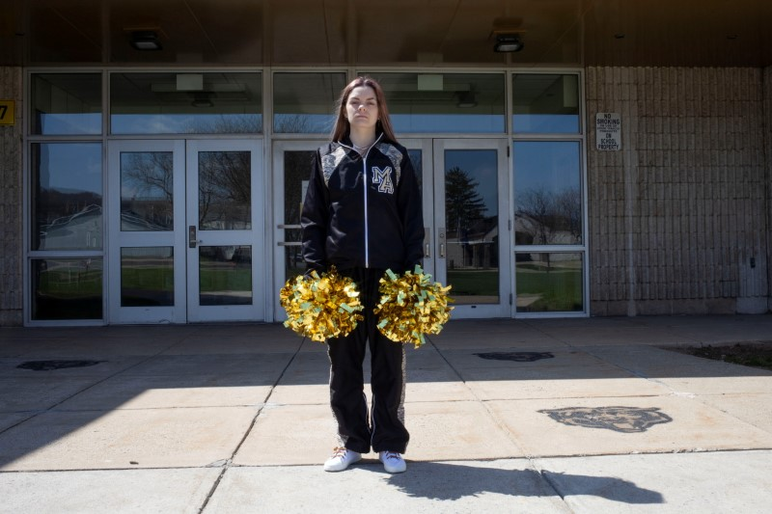
Know Your Student’s First Amendment Rights
Mahanoy Area School District v. B.L.
In 2021, U.S. Supreme Court held in an 8-1 decision that the school violated the student’s First Amendment right. Why?

Slide 11

Know Your Student’s Equal Access Act Rights
What about student clubs?
Federal Equal Access Act:
It shall be unlawful for any public secondary school which receives Federal financial assistance and which has a limited open forum to deny equal access or a fair opportunity to, or discriminate against, any students who wish to conduct a meeting within that limited open forum on the basis of the religious, political, philosophical, or other content of the speech at such meetings.
20 U.S.C. § 4071(a).

Slide 12
Know Your Student’s Equal Access Act Rights
If a public school permits non-curricular student groups, then it must allow students to form their own non-curricular groups and give them the same access and opportunities it does to other noncurricular clubs.
Non-curricular groups:
Groups that aren’t directly related to classes taught in the school.
Curricular groups:
The subject matter of the group is actually taught, or will soon be taught, in a regularly offered course (math club);
The subject matter of the group concerns the body of courses as a whole;
Participation in the group is required for a particular course; or
Participation in the group results in academic credit.

Slide 13
Know Your Students’ Equal Access Act Rights
If a public school permits non-curricular student groups, then it must allow students to form their own non-curricular groups and give them the same access and opportunities it does to other noncurricular clubs.
Straights & Gays for Equality v. Osseo Area Schols (8th Cir. 2008)
The MGHS-designated “curricular” student groups of cheerleading, synchronized swimming, Spirit Council, and Black Achievers were actually noncurricular groups that received greater access than SAGE, in violation of the EAA.
Upheld a permanent injunction that required MGHS to give SAGE the same access for meetings, avenues of communication, and other miscellaneous rights as those afforded to the mis-classified non-curricular groups.

Slide 14



Know Your Student’s LGBTQ+ Rights
Panels from the Freedom To Be Monument, National Mall, Washington D.C., May 17, 2025

Slide 15

Know Your Student’s LGBTQ+ Rights
LGBTQ+ (and allied) students have the right to:
Be protected from bullying and harassment.
Be addressed using the student’s preferred name and pronouns.
Express support for the LGBTQ+ community and dress consistent with their gender identity.
Have dress codes enforced equally and not based on stereotyping or censoring particular viewpoints.
Self-report their gender identity.
Form LGBTQ+ student groups (GSA, Pride Alliance) with the same school support as other student groups.
Access books on library shelves that include LGBTQ+ characters and stories.
(MHRA; Safe and Supportive Schools Act; Minn. Const. Art. 1 § 2 & 3; Book Ban Statute (Minn. Stat. 134.51).)

Slide 16

Know Your Student’s LGBTQ+ Rights
Transgender students have the right to use the same restrooms and locker rooms as other students, consistent with students’ gender identity. (N.H. v. Anoka-Hennepin Sch. Dist. No. 11, 950 N.W.2d 553 (Minn. Ct. App. 2020); Minnesota Human Rights Act (MHRA); Minn. Const. Art. 1 § 2.)
Transgender students have the right to participate in school activities and on teams in a way that aligns with their gender identity. (Minn. Op. Atty. Gen. 1035 (Feb. 20, 2025); MHRA; Minn. Const. Art. 1 § 2; Minnesota State High School League 300.03, 2024-2025 MSHSL Official Handbook.)

Slide 17
Schools Are Authorized and Obligated to Protect LGBTQ+ Students’ Privacy.
Students have the right to ask that a school keep their sexual orientation and gender identity private. Family Educational Rights and Privacy Act (FERPA); Minnesota Government Data Practices Act (MGDPA).
Casual use of a student’s incorrect pronoun or incorrect name, revealing the student’s transgender status, may violate FERPA and MGDPA.
Disclosure of private information regarding a student’s transgender status could amount to harassment and discrimination under the Minnesota Human Rights Act and Minn. Const. Art. 1 § 2.
Students have the right to know of all individuals, agencies, and organizations that have requested the student's personal information from the student’s school. (FERPA requires schools and school districts to maintain this information within a student’s record.)

Slide 18
Know Your BIPOC Students’ Rights
BIPOC students have the right to an equal education, free from discrimination and censorship.
Schools must:
Eliminate racially biased disciplinary policies and practices.
Adopt an inclusive curriculum that acknowledges their experiences.
Address and remedy hostile school environments. (Note: schools can regulate student speech that creates a hostile school environment for students based on their protected class status such as their race, religion, gender, gender identity, sexual orientation or immigrant status)
Notes:
There is a fine line between First Amendment protected student speech and abusive speech that amounts to bullying and harassment, or threats. Schools have a responsibility to address situations where student speech has created a hostile school environment for students based on the student’s membership in a protected class such as their race, religion, gender, gender identity or sexual orientation. Student speech that rises to the level of creating a hostile school environment that interferes with the student’s ability to learn can and should be addressed by the school.

Slide 19
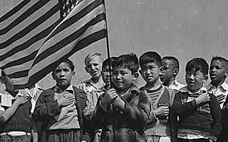
Know Your Immigrant Students’ Rights
Immigrant Students have the right to an equal education, free from discrimination and censorship.
Plyler v. Doe,
U.S. Supreme Court (1982)
Notes:
https://www.maldef.org/2018/12/plyler-case/
Every child deserves a fair chance to learn and thrive. That might seem an obvious statement today, but it took years of legal battles fought by MALDEF to ensure that “every” child did not exclude any child – particularly, immigrant children.
After nearly five years of litigation, the U.S. Supreme Court ruled in 1982 that all children, regardless of immigration status, have a constitutional right to a free public education from kindergarten to 12th grade. The landmark case, Plyler v. Doe, grew out of a 1977 attempt by the Tyler Independent School District in Texas to oust the children of undocumented workers – farmhands, for the most part – from the school system by imposing tuition of as much as $1,000 per student to attend what were for everyone else free public schools.
Tyler ISD based its move on legislation passed by Texas lawmakers requiring the state to withhold funds to school districts that enrolled undocumented immigrant students. MALDEF sued in September 1977 – and while a federal court quickly granted a motion to block Tyler ISD from denying enrollment based on immigration status, the case underwent numerous appeals and took four more years to reach the Supreme Court.
Writing for the majority, Justice William J. Brennan Jr. concluded that “education provides the basic tools by which individuals might lead economically productive lives to the benefit of us all” and that the state could not constitutionally deny such an education to undocumented children.
The Court’s ruling reflected the notion that “children generally should be expected to stay and benefit from staying with their parents, and they should not be punished for staying with their parents,” said MALDEF president and general counsel Thomas A. Saenz, noting that three key aspects of the Plyler case resonate in today’s divided political climate:
The Supreme Court recognized that tuition would prevent most undocumented children from ever attending school. Plyler outlaws not only policies that directly bar immigrant students from enrolling in school, but also indirect attempts that discourage enrollment, such as collecting or sharing data on students’ or parents’ status, or immigration enforcement activity on or near public schools.
Although Plyler was a 5-4 decision, all nine justices agreed that the Texas attempt to charge tuition to undocumented children was bad public policy. Chief Justice Warren Burger began his dissenting opinion by stating that he “would agree without hesitation that it is senseless for an enlightened society to deprive any children . . . of an elementary education.”
Plyler was grounded in two critical American values – that individuals should be judged based on their own actions, not those of their parents, and that our nation welcomes and depends upon immigrants.
These lessons were lost on the Trump administration. Former Education Secretary Betsy DeVos demonstrated, as Saenz told The Washington Post, “astounding ignorance of the law” when she testified before Congress that local school districts could decide whether to report students to immigration authorities. Her testimony was not just a misinterpretation of Plyler. It was flat-out wrong. Of all people, the Education Secretary must be fully cognizant that Plyler did much more than just grant entry to public schools for all children.
Plyler mandates that no government entity – be it a local school district or a state legislature or the U.S. Department of Education – institute policies that would in any way discourage a child from enrolling in school. If parents keep their kids at home because immigration authorities are allowed to patrol campuses or transit systems that take children to schools, that’s a Plyler violation. If students are afraid to go to school because of anti-immigrant bullying or anything else that creates a fearful environment, that’s a Plyler violation.
Nevertheless, the Plyler ruling has not discouraged challenges over the years. California tried it in 1994 under Proposition 187, the referendum that sought to cut off critical access to public schools for undocumented immigrants. A federal court ruled most of the law was unconstitutional, but not until after several tense years of litigation.
Alabama also tried it in 2011, when the state passed a measure requiring school districts to ask students about their immigration status. The measure was struck down after the Obama administration sued on the grounds that it violated Plyler.
And 21 years later, Texas Governor Greg Abbott raised the idea of challenging the Court’s decision on Plyler. Abbott’s remarks – uninformed and revealing a critical misunderstanding of Plyler – were nothing more than cynical dog-whistle to his base; a lame attempt to employ fear of immigrants to rally racist voters to support his re-election.
Unfortunately, Abbott, Alabama and the Trump administration are part of a seemingly unending stream of craven politicians and legislatures willing to use children in their war on immigrants. With an increasingly conservative Supreme Court – one that has shown itself to be willing to reverse rights granted to women in the 1970s – it is important to revisit Plyler and explore why we must remain vigilant to attacks against it.
MALDEF will be on guard against further challenges. As Saenz wrote, “Those who would today assert that depriving children of an education is appropriate policy should be mindful of the views of all nine justices in Plyler.”

Slide 20
Know Your Students’ Rights
1.) Do the protections of free speech and laws against bullying and harassment in Minnesota public schools also apply to students who don’t have immigration status?
YES.
2.) If a child or their family is in the United States without immigration status, do they have the right to go to a public school in Minnesota in the first place?
YES.
3.) But don’t Minnesota public schools ask the parents of enrolling students to provide the student’s birth certificate or social security card?
YES, sometimes, but only for other purposes, and never to check the immigration status of an enrolling child or that child’s family members.

Slide 21
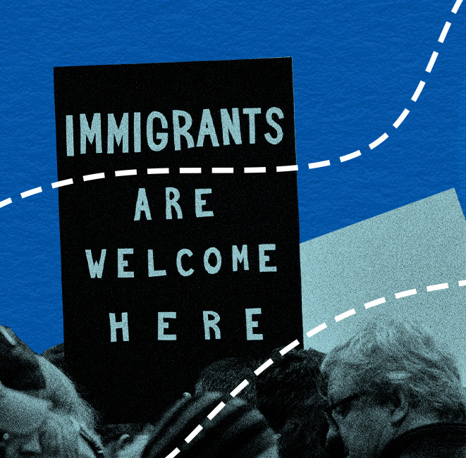
Know Your Students’ Rights
Schools cannot discriminate against students on the basis of race, color, or national origin.
Undocumented children cannot be denied their right to a free public education, and schools should not require families to prove their immigration status in order to enroll their children in school.
Students with limited English proficiency cannot be turned away by public schools, which must provide them with language instruction.

Slide 22
All Students Should Know Their Rights!
If you’re stopped by a police officer at your school, stay calm. Don’t argue, resist, run away, or otherwise interfere with the officer. Ask if you’re free to leave. If the answer is yes, calmly and silently walk away from the officer.
If the officer asks you a question, you have the right to remain silent. You also have the right to refuse to write or sign a statement. But if you waive these rights, anything you say, write, or sign can be used against you. And if you choose to make a statement, ask to have a lawyer, parent, or guardian present before you are questioned.
You can refuse to give your consent to be searched by the police. This may not stop the search, but this is the best way to protect your rights if you end up in court.
Don’t consent to a phone search; police need a warrant to search your phone. The same goes for a strip-search. No police officer or school employee has the authority to strip-search you.
Don’t resist, fight, or flee from an officer who is arresting you. Say you wish to remain silent and ask for a lawyer immediately. Don’t say anything, sign anything, or make any decisions without a lawyer present.

Slide 23
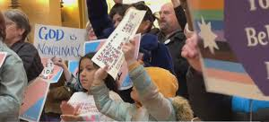
Trends On Extremist School Boards
Photo Credit WCCO

Slide 24
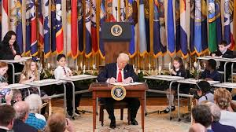
Unprecedented Federal Attack Against Public Schools
E.O. 14280 declaring any race-conscious effort to remedy racial disparities in school discipline as illegal racial discrimination under Title VI
E.O. 14201 to prohibit transgender female athletes from participating in girls’ and women’s sports teams.
E.O. 14151 to end all DEI, DEIA, and environmental justice programs and support across the federal government.
E.O. 14190 ordering federal funding termination for schools that promote DEI or teach about racism, bias, and/or “gender ideology.” Also attempts to require schools to inform parents about children’s gender identity.
Feb. 14 Dear Colleague Letter declaring DEI and any other race-conscious program or policy illegal under Title VI, which prohibits racial/ethnic discrimination in federally funded institutions.
E.O. 14168 mandating that federal departments define gender as unchangeable male-female binary determined by sex assigned at birth
July 25 Department of Education freezes $6 billion K-12 and adult education funding

Slide 25

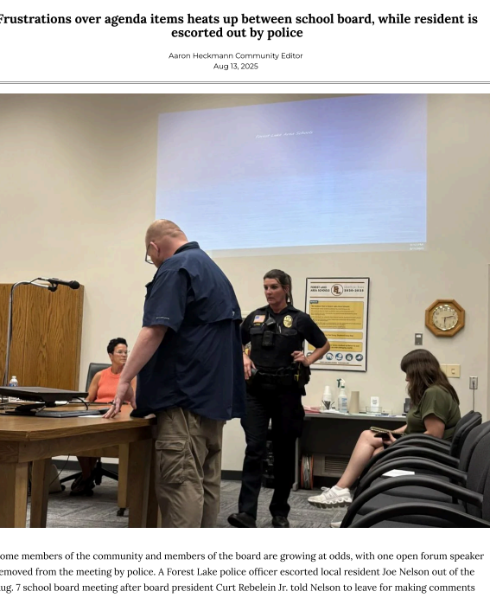
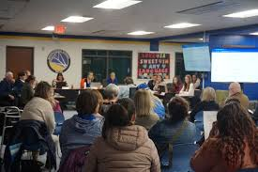
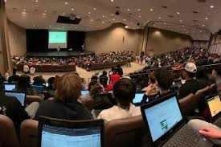
Unprecedented Local Attacks Against Minnesota Public Schools
Hundreds of students at Maple Grove Senior High “opt out” of LGBTQ+ history lesson.
Stillwater school district removes books representing LGBTQ+ characters from shelves.
St. Francis School Board adopts policy that allows books to be removed from library and classrooms based on reviews by right-wing conservative Christian website.
Forest Lake School board moves to rescind policy outlawing wearing of white supremacy hate symbols and change student club policy to exclude identity-based groups.
Hastings and Prior-Lake Savage school boards repeal equity and inclusion policies.

Slide 26
Trends To Watch For: Book Bans and Book Removals
What might happen:
School Board revising or drafting Library Materials Policy to limit librarian’s independence and to expand school board oversight over materials.
Increasing numbers of successful challenges to library books to remove the books from library or classrooms.
Reports that books have been unilaterally removed from library or classroom shelves by school employee or school board member.
Public campaign to remove books from library shelves.
Legal Authority
Book Ban Statute. “A public library must not ban, remove, or otherwise restrict access to a book or other material based solely on its viewpoint or the messages, ideas, or opinions it conveys.” (Minn. Stat. 134.51.)
Freedom of speech. Freedom to learn. (Minn. Const. Art. 1 § 3.)
Right to general and uniform system of public schools. (Minn. Const. Art. 13 § 1.)

Slide 27
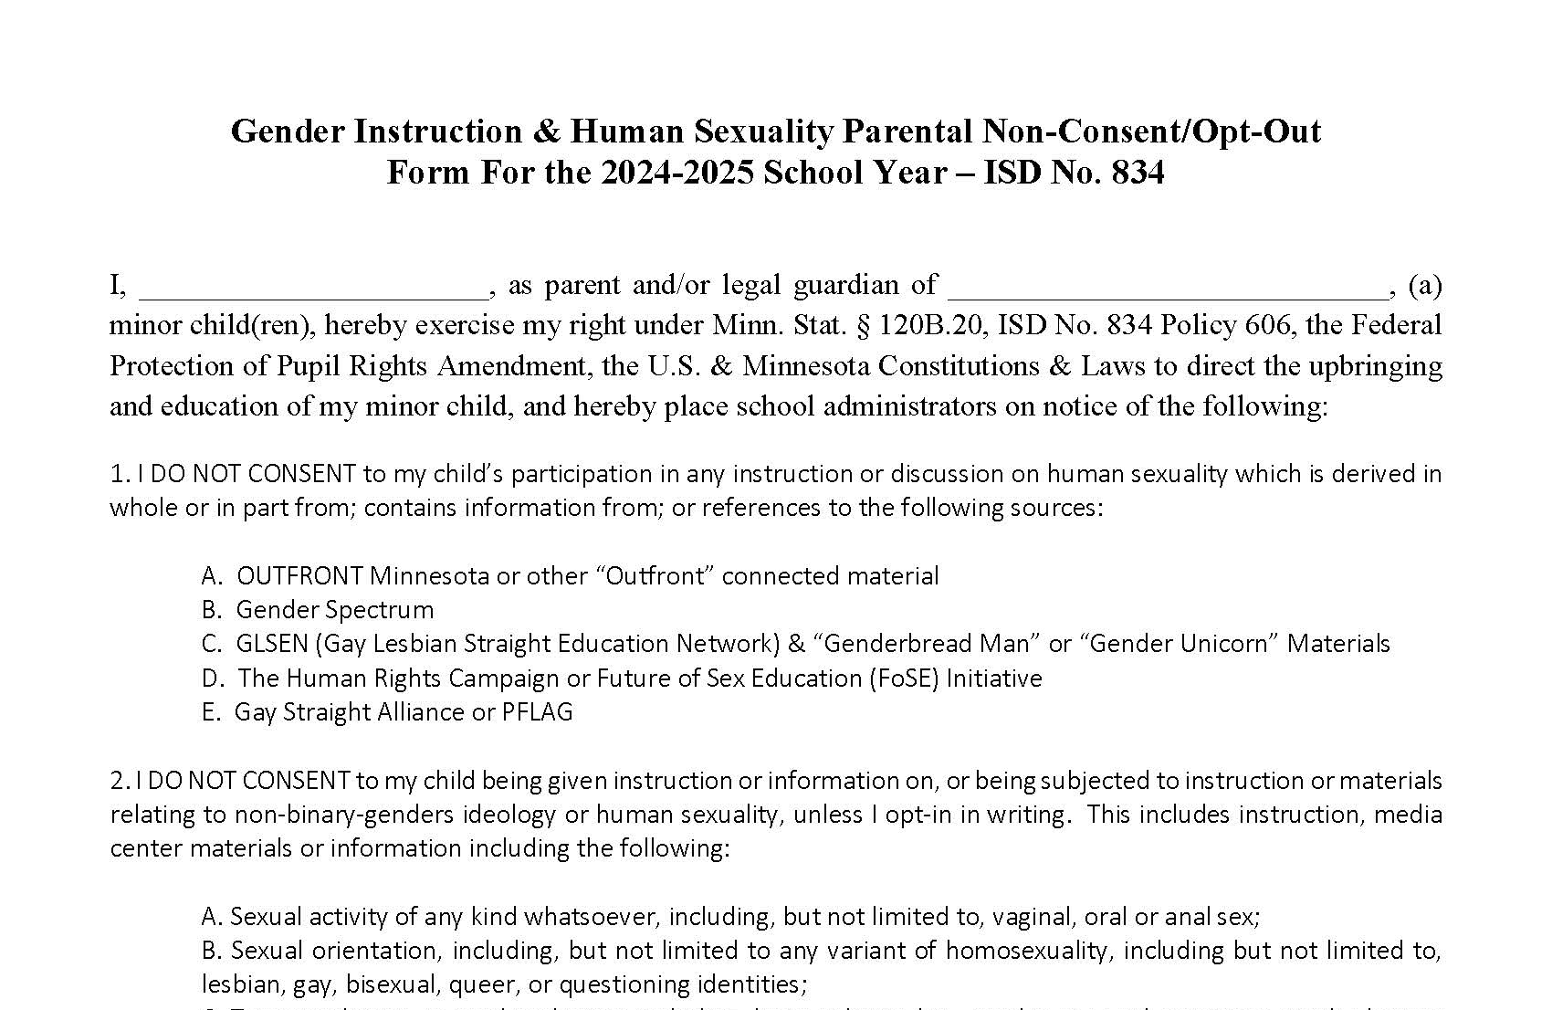
Trends To Watch For: Opt Outs
What might happen:
Groups of parents seeking global opt outs from specific representation in curriculum and books, often LGBTQ+ representation.
School Board/Administrators removing books from shelves in classrooms and/or libraries or locking up books because of broad opt out requests.
School district accommodating hundreds of opt outs without requiring parents to review curriculum and make alternative instruction arrangements and in a manner that stigmatizes and harms students from protected classes.
Legal Authority
Under Minnesota law, parents may review the content of instructional materials and “opt out” their child from specific content by making reasonable arrangements for alternative instruction. (Minn. Stat. 120B.20.)
Schools must administer opt out requests so they do not create a discriminatory environment for students based on their race, religion, national origin, sex, gender identity, status with regard to public assistance, sexual orientation, or disability. (MHRA and Minn. Const.)
Recent Supreme Court decisions do not meaningfully impact our opt out and human rights laws. (Mahmoud v. Taylor, 145 S.Ct. 2332 (2025))
The opt out law does not allow opt outs from library books, classroom discussions, wall hangings, etc.

Slide 28
Trends To Watch For: Rescinding DEI Efforts/Curriculum Changes
What might happen:
School Board rescinding diversity, equity, and inclusion policies or resolutions.
School Board eliminating DEI positions.
The termination of district leaders who are pursuing anti-racist and inclusive curriculum.
School Board refusing to adopt curriculum compliant with elements of state-mandated academic standards to avoid representation of diverse communities or ethnic studies.
Legal Authority:
Minnesota legislature sets academic standards and school districts must adopt curriculum that meets those standards.
Schools cannot discriminate based on students’ race, religion, national origin, sex, gender identity, status with regard to public assistance, sexual orientation, or disability. MHRA and Minn. Const.
DOE “Dear Colleague” letter directing states to “certify” their “compliance” with “antidiscrimination obligations” by eliminating DEI programs in order to continue receiving federal financial assistance. Three judges have issued preliminary stays and injunctions of these requirements.

Slide 29
Trends To Watch For: Anti-Inclusion Actions
What might happen:
School Board restricting ability to form affinity clubs (cultural, BIPOC, LGBTQ+, etc.).
School Board rolling back or refusing to adopt gender inclusion policies.
School Board or community members seeking to exclude participation in sports consistent with gender identity in the name of “compliance” with demands of federal Department of Education.
School Board restricting student speech and expression in support of LGBTQ+, BIPOC, immigrant communities.
Legal Authority
If school permits noncurricular student groups, then it must allow students to form their own non-curricular groups with same access and opportunities as other noncurricular groups. (Equal Access Act.)
N.H. v. Anoka-Hennepin Sch. Dist. No. 11, 950 N.W.2d 553 (Minn. Ct. App. 2020); MHRA; Minn. Const. Art. 1 § 2 & 3; Minn. Op. Atty. Gen. 1035 (Feb. 20, 2025); MSHSL 300.03, 2024-2025 MSHSL Official Handbook. (While federal DOE Office of Civil Rights recently made findings to the contrary, the action is ongoing and those findings do not have the force of law.)
Freedom of speech. Freedom to learn. (Minn. Const. Art. 1 § 3.)

Slide 30

Trends To Watch For: School Board Standing Up For Students
What might happen:
School Board upholds students’ right to learn in the face of threats from those seeking to limit that right.
What to do:
When they stand up for students, let your school board, administrators, and teachers know that the community supports them and has their back!

Slide 31

What Can You Do? Join School Board Watch

Slide 32
Learn more about your school board!
Three questions to start…
1. When and where does my school board meet?
Check your school district’s website for information on school board meetings.
2. What is my school board doing?
Review meeting minutes and agendas to find out about proposed changes to policies and curriculum, which are often introduced and voted on during school board meetings.
3. How can I get involved?
Attend school board meetings in person or by tuning into a live stream or video recording.

Slide 33
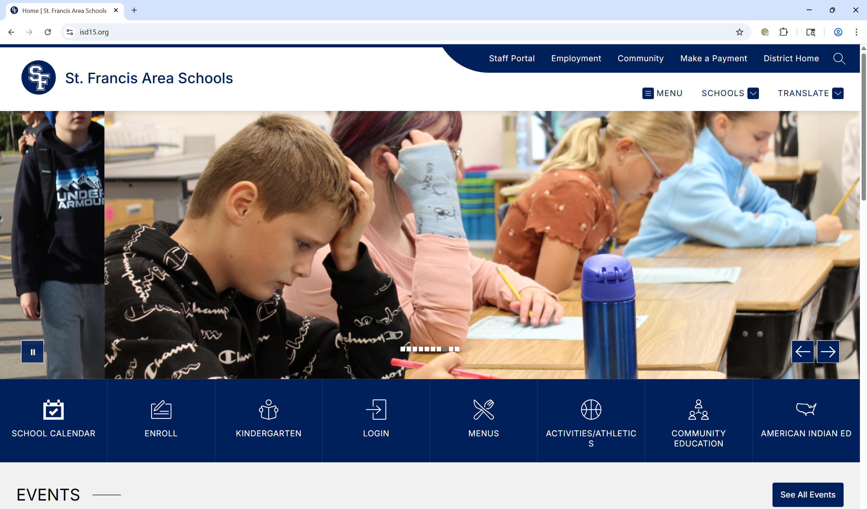
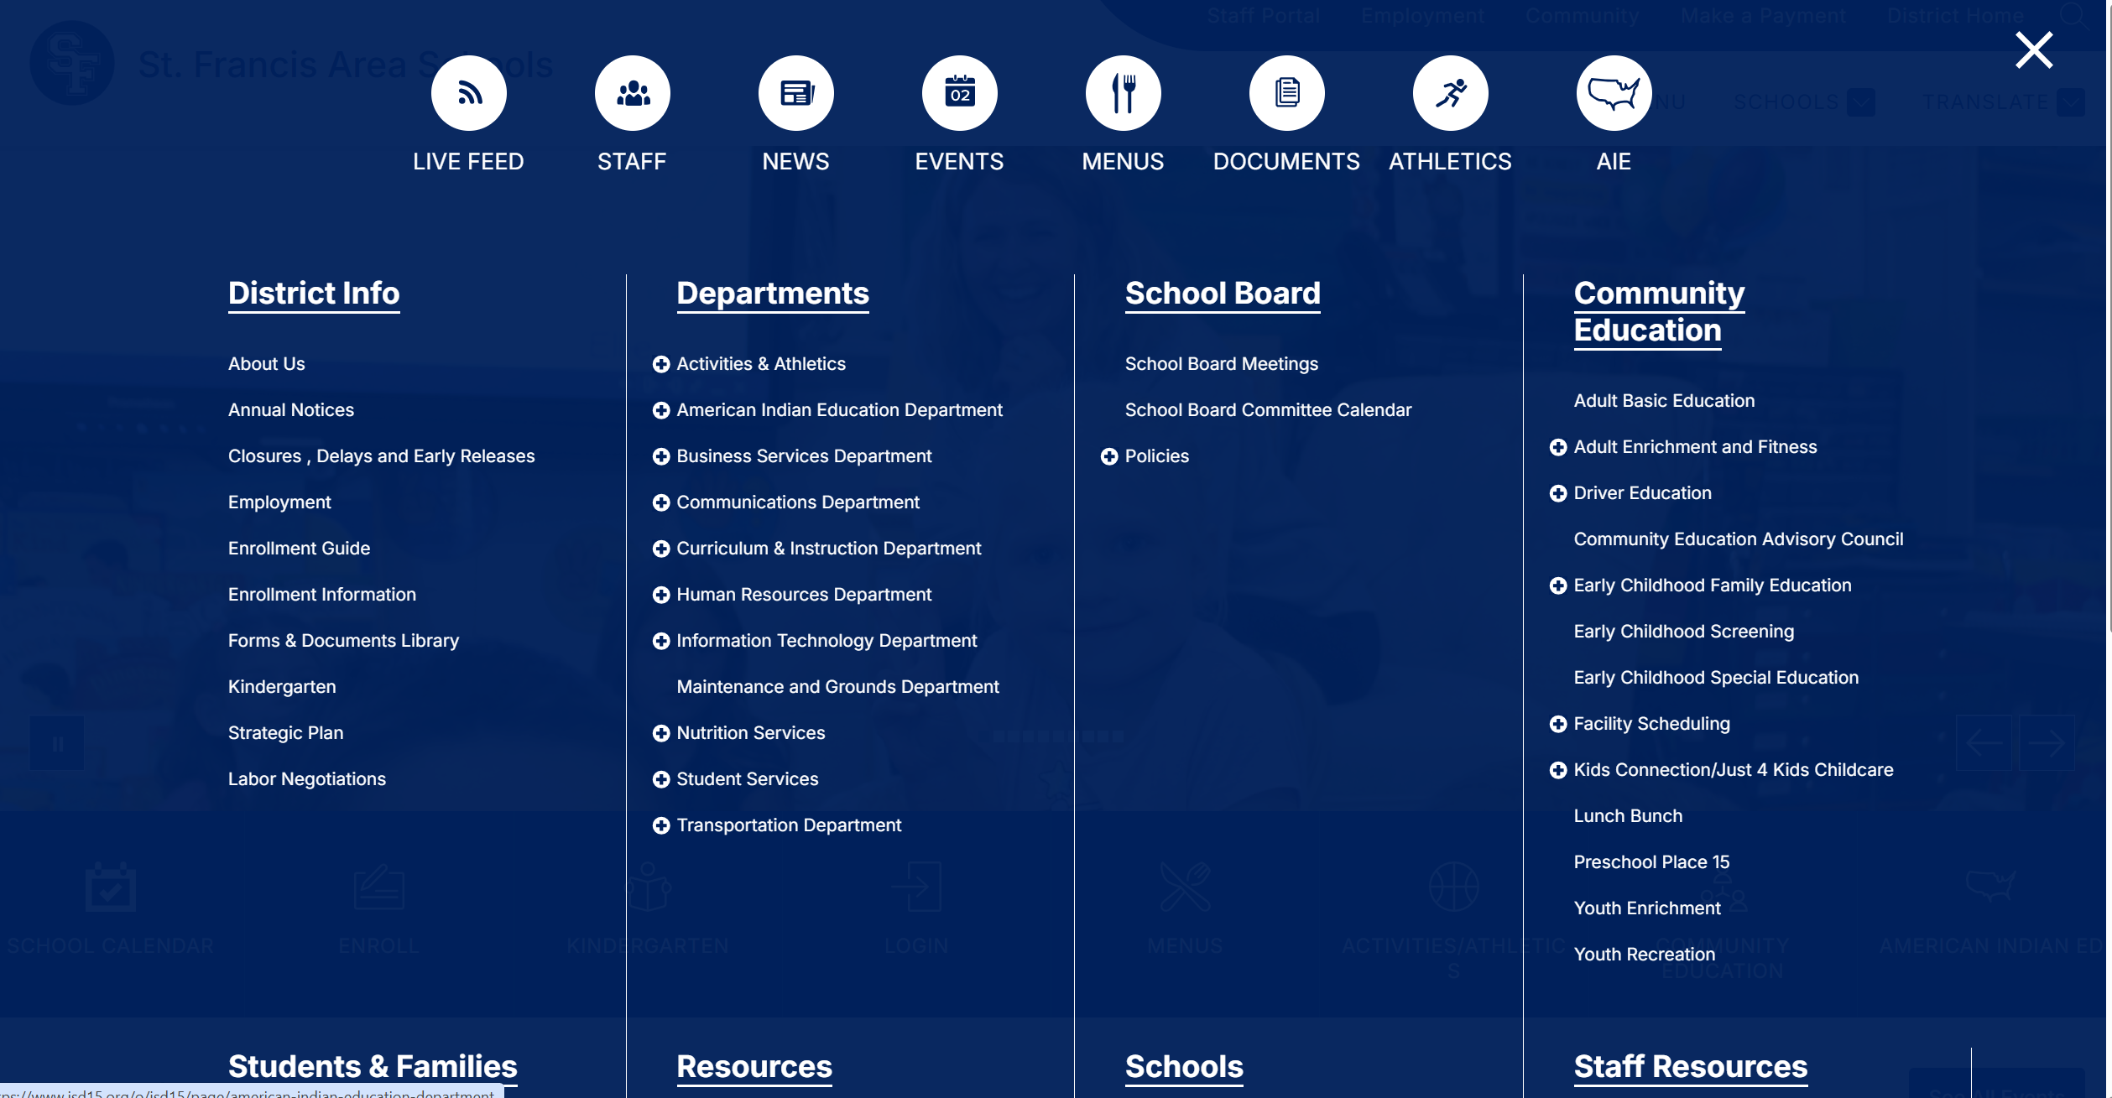
Example: St. Francis Area Schools
When and where does my school board meet?
Find the School Board’s webpage by clicking through district’s website.

Slide 34
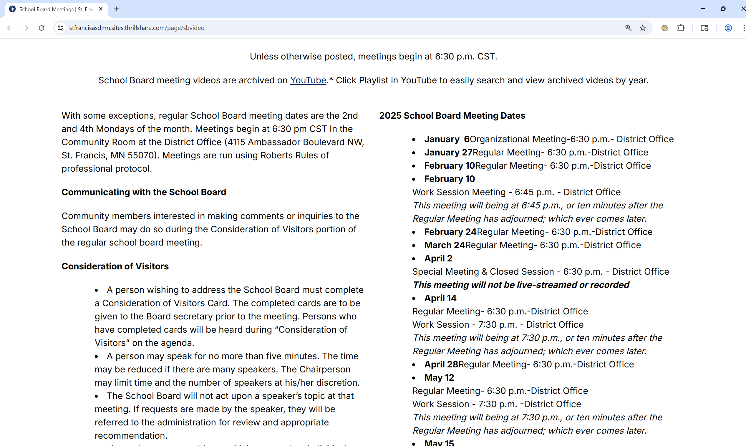
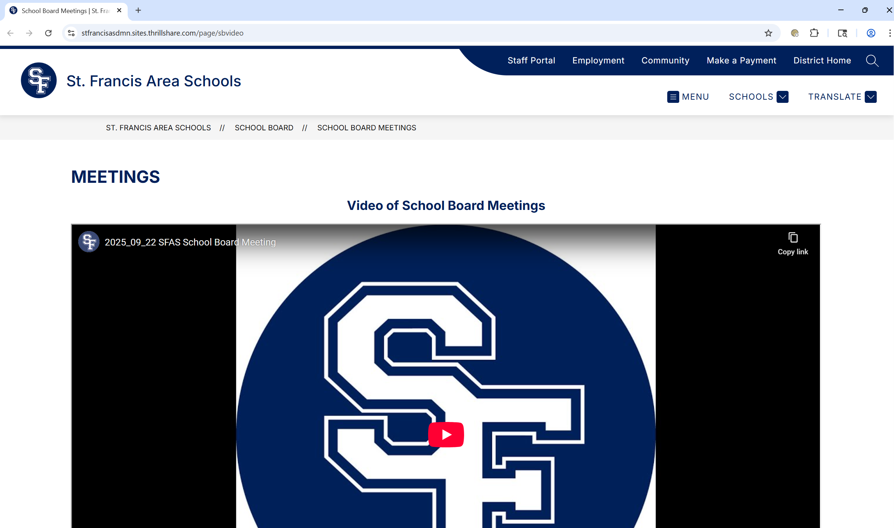
Example: St. Francis Area Schools (continued)
When and where does my school board meet?
Scroll through the school board’s website to find out when the board typically meets. Look for a list of upcoming meetings.

Slide 35
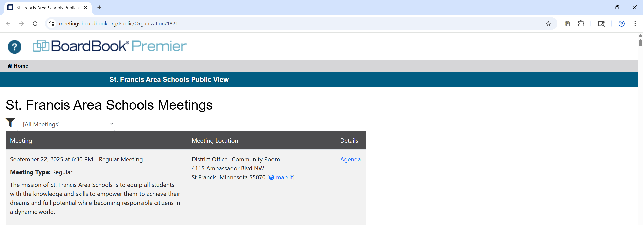
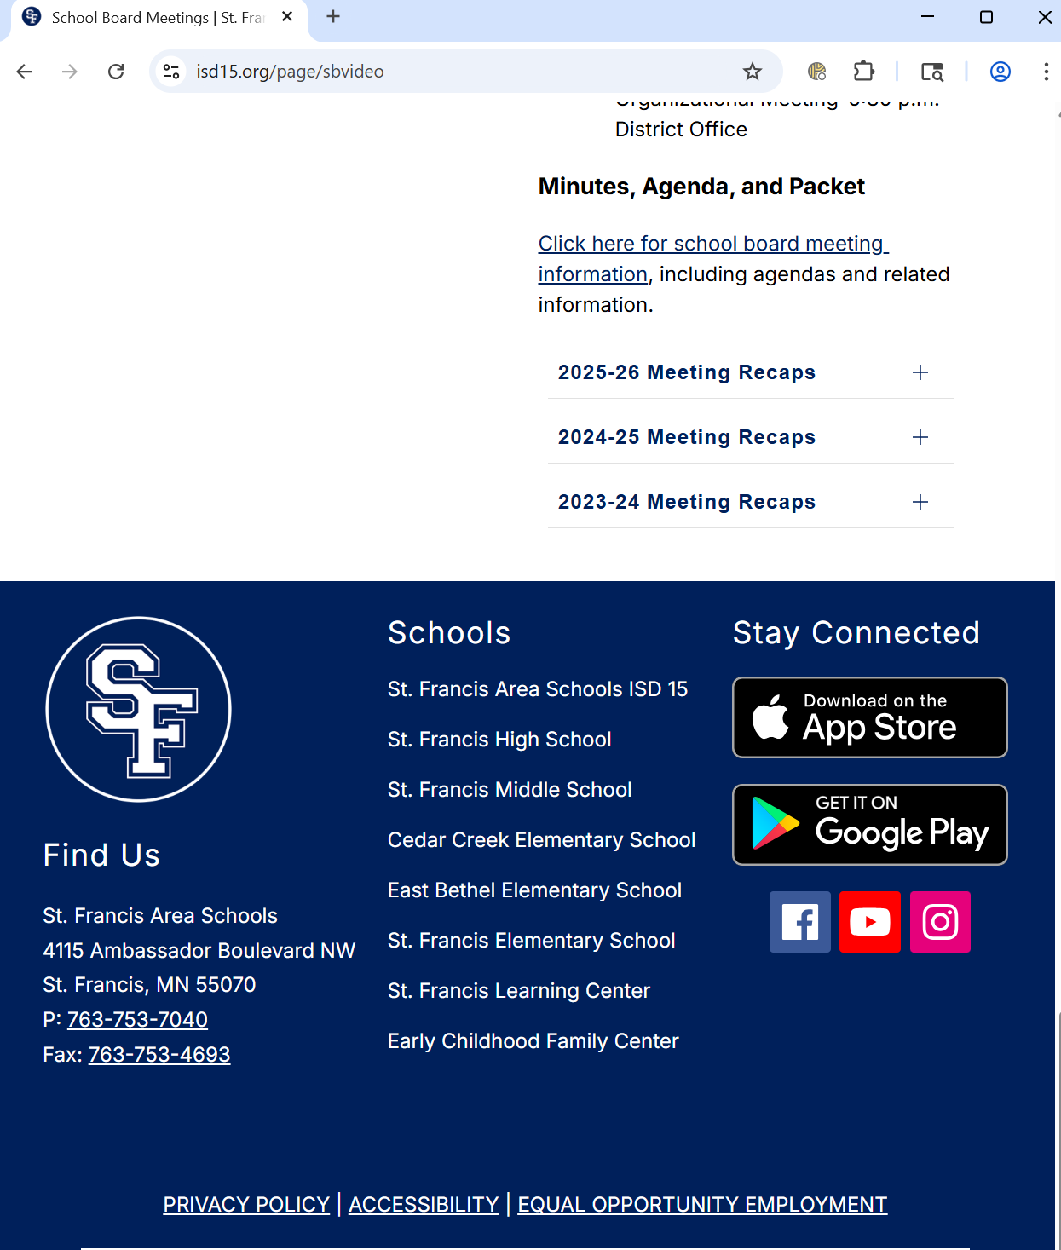
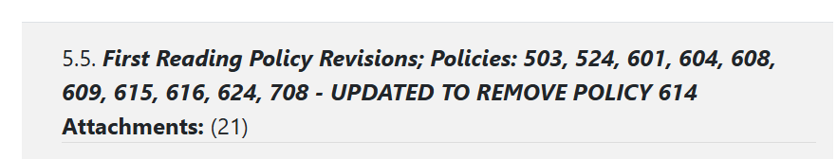
Example: St. Francis Area Schools (continued)
2. What is my school board doing?
Read the agenda to learn about the school board’s plans.
Look for a link to board meeting materials.
Look for items on the agenda that indicate upcoming changes or revisions to curricula and policies.
Example: the St. Francis school board reviewed changes to their library policy at their November 25, 2024 meeting.

Slide 36
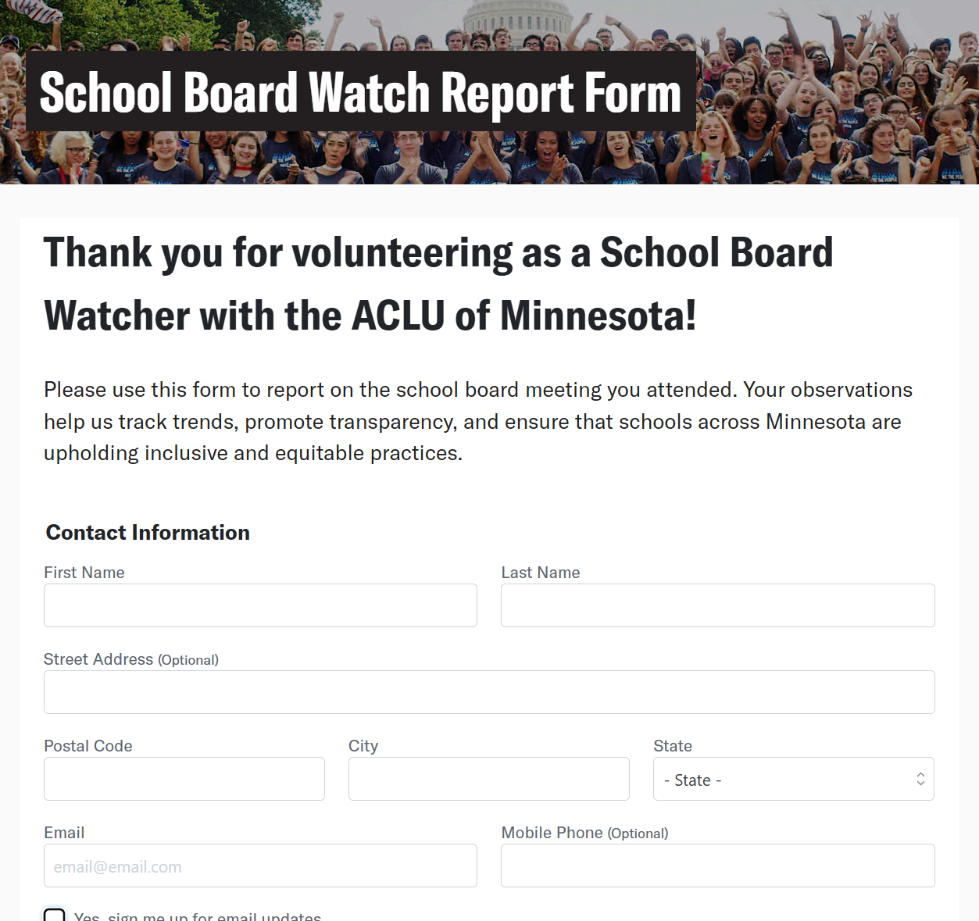
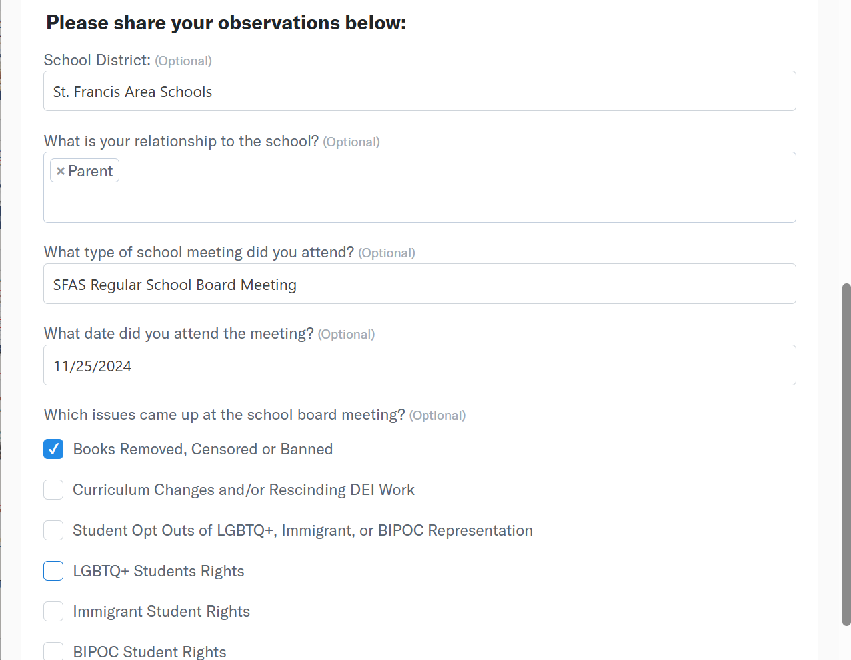
Example: St. Francis Area Schools (continued)
3. How can I get involved?
Attend school board meetings in person or by tuning into a live stream or video recording.
and....join ACLU of Minnesota’s School Board Watch!
Next Meeting:
Nov 11th 7PM (Virtual)

Slide 37
Know Your Students’ Rights
QUESTIONS?

Slide 38
We the people.
www.aclu-mn.org

