Slide 1
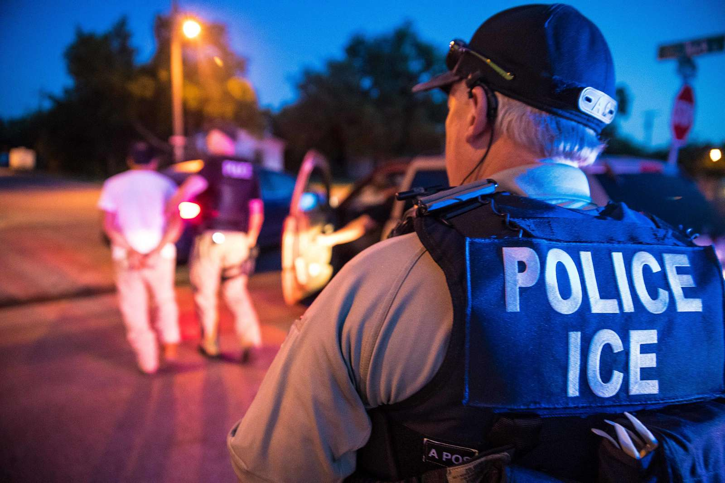
ACLU OF MINNESOTA
KNOW YOUR RIGHTS WITH ICE

Slide 2


ACLU OF MINNESOTA
CONTENTS
1 — Your rights
2 — Warrants
3 — ICE encounters
4 — Be prepared
5 — ICE roleplay

Slide 3
ACLU OF MINNESOTA
I want to remain silent.
Quiero permanec-er en silencio.
I don’t consent to a search.
No doy mi consenti-miento para una búsqueda.
Am I free to go?
¿Soy libre de irme?
I want to speak to an attorney.
Quiero hablar con un abogado.

Slide 4
ACLU OF MINNESOTA
YOUR RIGHTS
You have the right to remain silent and do not have to discuss your immigration or citizenship status with police, immigration agents, or other officials.
If you want to exercise your right to remain silent, say so out loud: “I want to remain silent.”
To ask for your immigration documents, an officer must have a reasonable suspicion of a crime or a violation of immigration law. If you do not answer any questions, law enforcement will not have a valid reason to ask for your immigration documents.
Notes:
Does ICE need a judicial warrant to see your papers?
Reasonable suspicion of a crime or violation of immigration law (race isn't enough, can't )
won't have grounds
Can't be forced to produce documents unless warrant (even if arrested)

Slide 5
ACLU OF MINNESOTA
YOUR RIGHTS
You do not have to answer any questions by law enforcement without an attorney present.
If the police or ICE question you, assert your right to remain silent and tell them “I want to speak to an attorney.”
Do NOT lie about your citizenship status or provide fake documents.
Do NOT sign anything unless you have spoken to an attorney.

Slide 6
ACLU OF MINNESOTA
EXCEPTIONS
If you are arrested by the police, you have the right to a government-provided attorney; if you are arrested by ICE you have the right to an attorney, BUT the government does not have to provide one.
In Minnesota, you do not have to provide your name to law enforcement unless they suspect you of a crime, BUT in some other states you do (like North Dakota or Wisconsin).
If an immigration agent asks to search you, you have the right to say no.
You do not have to consent to a search by law enforcement, BUT they may pat you down if they suspect a weapon.

Slide 7
ACLU OF MINNESOTA
KNOW YOUR WARRANTS
A judicial warrant is signed by a judge. There are two main types:
  A search warrant allows law enforcement to enter the address listed on the warrant, but officers can only search the areas and for the items listed.
  An arrest warrant allows law enforcement to enter the home/workplace of the person listed on the warrant if they believe the person is inside. This is signed by a judge.
An administrative warrant (“ICE warrant”) does NOT allow officers to enter a home/workplace without consent. This is NOT signed by a judge.

Slide 8
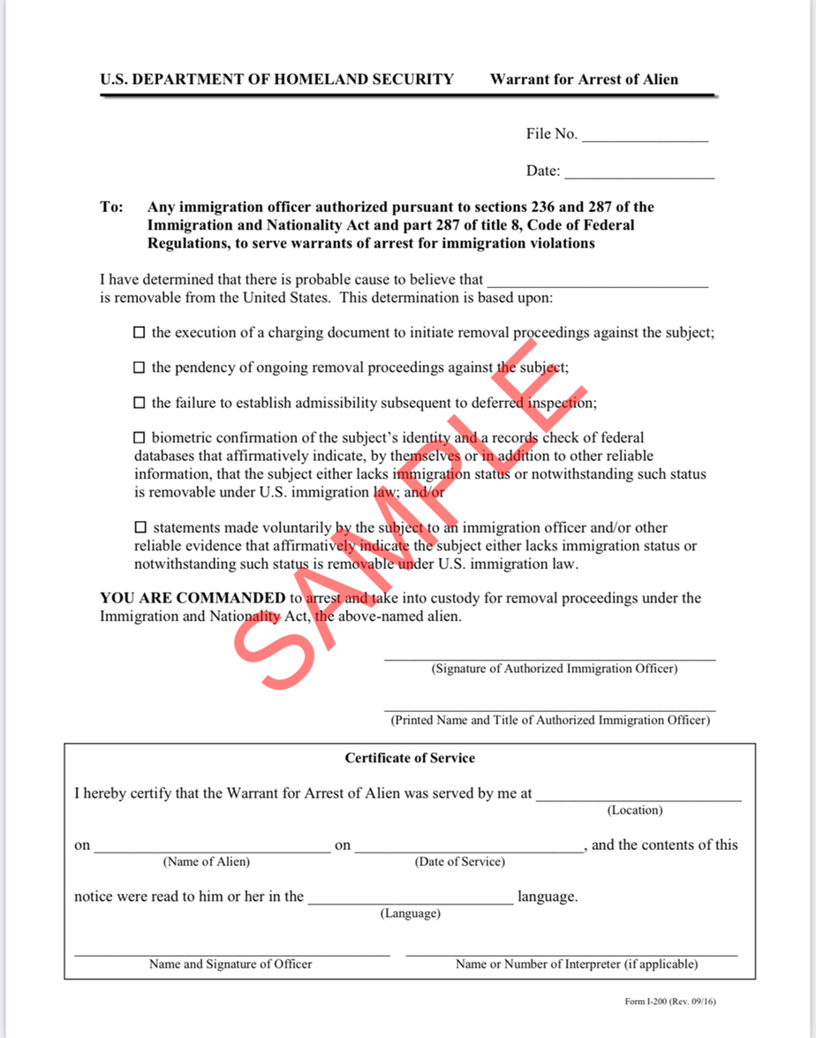
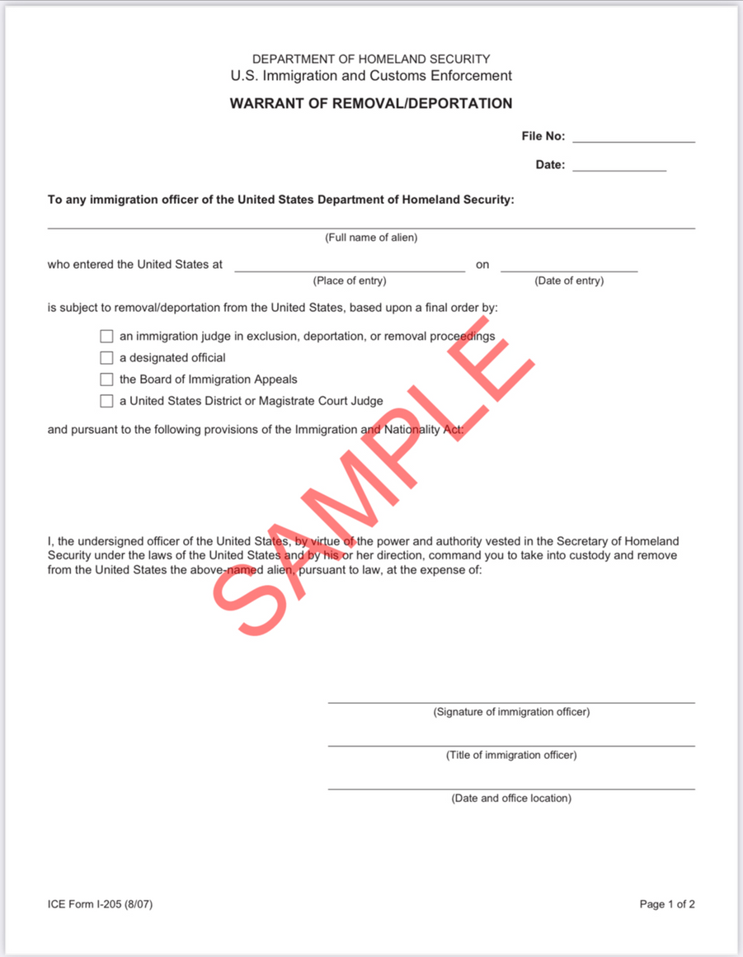
ICE “WARRANTS”
NOT issued by a court
NOT signed by a judge

Slide 9
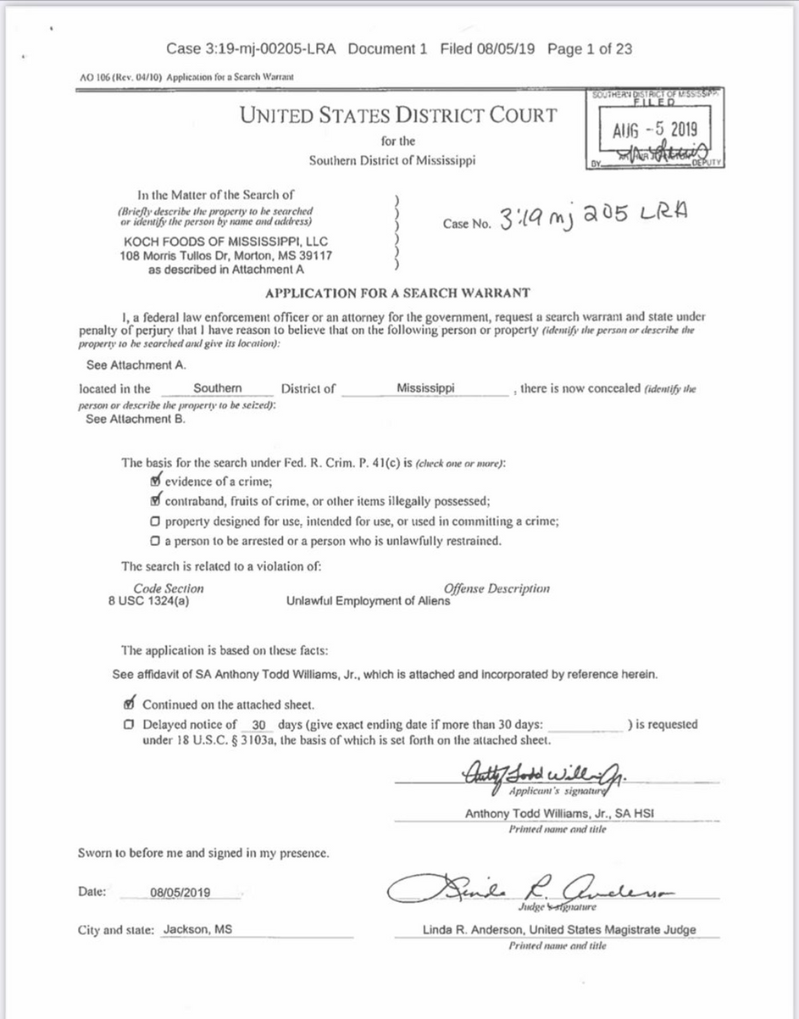
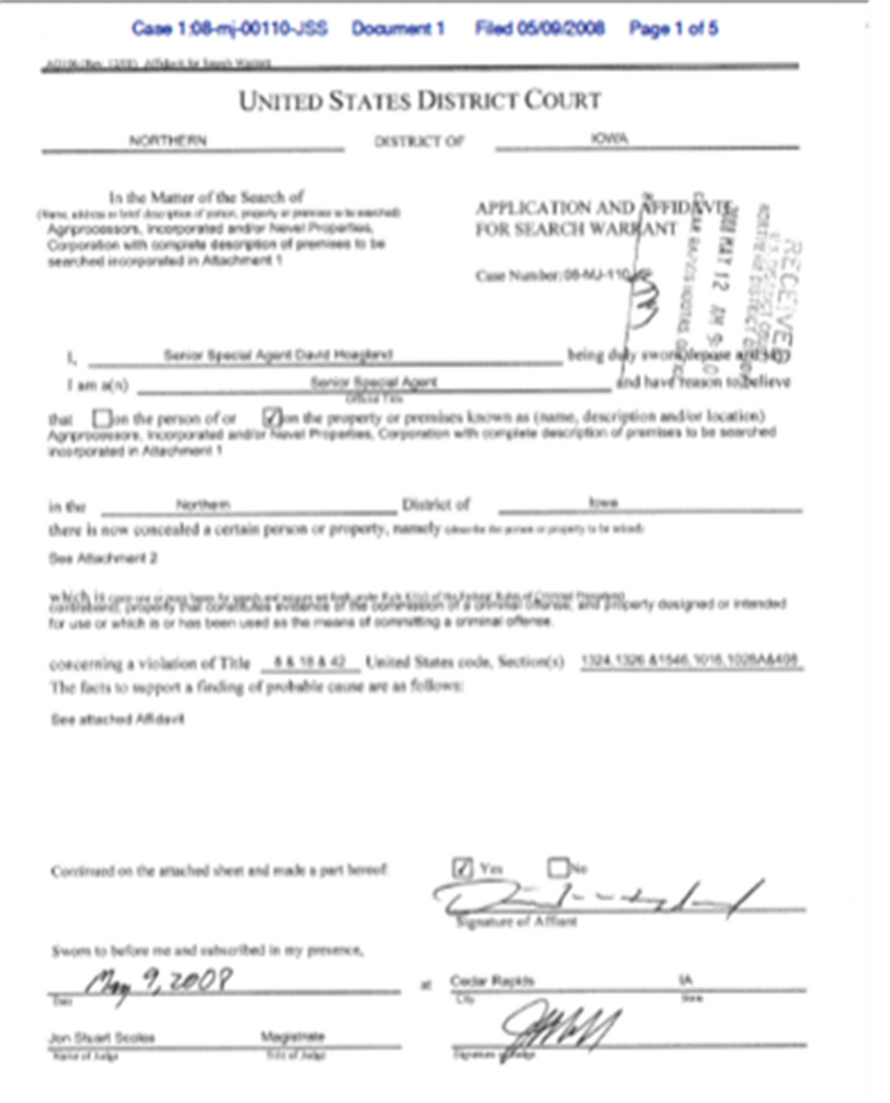
JUDICIAL WARRANTS
YES issued by a court
YES signed by a judge

Slide 10
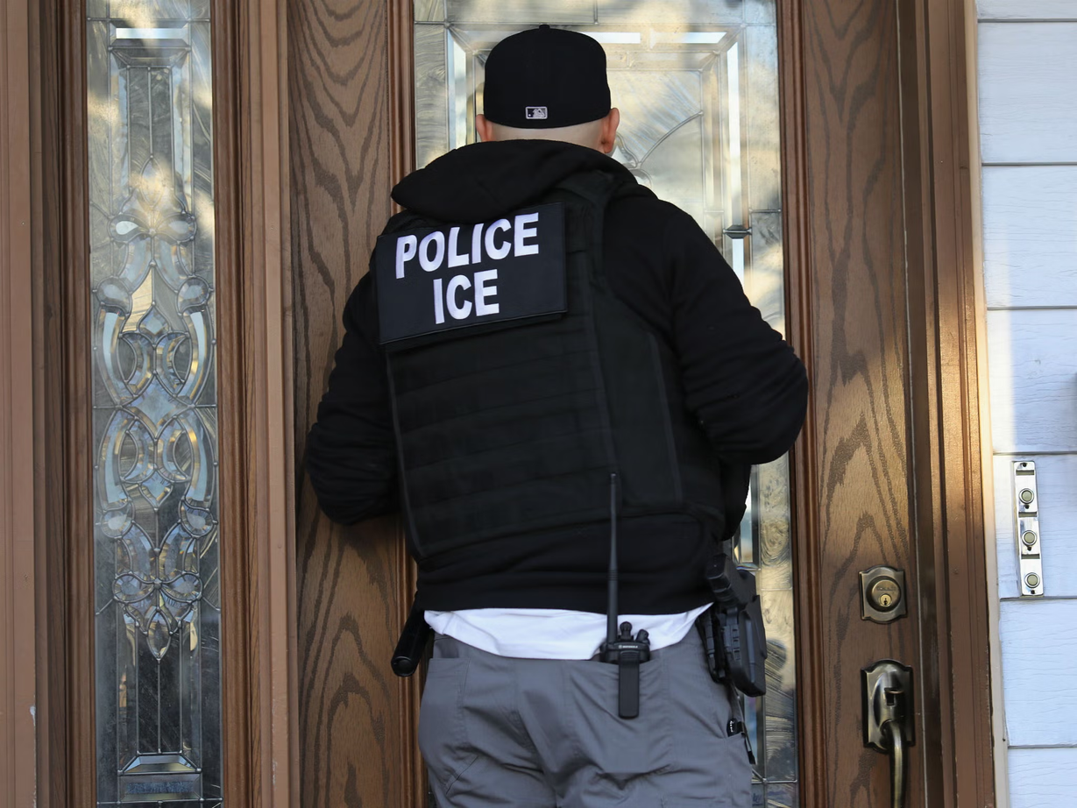
ACLU OF MINNESOTA
IF ICE COMES TO YOUR HOME
Ask if they are ICE or CBP agents and why they are there. Do NOT open the door.
Ask them to show you their badge/ID through a window/peephole.
Ask them if they have a warrant signed by a judge; if they do, ask them to slide it under the door or hold it up to a window for inspection.

Slide 11
ACLU OF MINNESOTA
IF ICE COMES TO YOUR HOME
A valid judicial warrant must be signed by a judge and either (1) name a person in your residence who is present, or (2) and/or areas to be searched at your address.
If the person named on an arrest warrant is home, send them out to talk to ICE instead of letting agents in.
If they do not produce a warrant, keep the door closed. Tell them: “I do not consent to your entry.”

Slide 12
ACLU OF MINNESOTA
IF ICE COMES TO YOUR HOME
If agents force their way in, stay calm and do not resist. If you wish to exercise your rights, state: "I do not consent to your entry or to your search. I want to remain silent. I want to speak with an attorney.”
IF agents do have a warrant signed by a judge, you must let them in. BUT continue to assert your rights out loud.
Make sure your children and elders know not to open the door or talk to ICE!

Slide 13

ACLU OF MINNESOTA
IF ICE PULLS YOU OVER DRIVING
If you are pulled over by law enforcement, ask if they are ICE or CBP agents and why you have been stopped. Do NOT open the car door.
When you are pulled over driving, you must show law enforcement your driver’s license, registration and insurance. Do not lie or give them fake documents.
If an officer asks to search your car, ask if they have a warrant signed by a judge. If not, tell them “I do not consent to your search of my vehicle.”

Slide 14
ACLU OF MINNESOTA
IF ICE PULLS YOU OVER DRIVING
If an officer continues asking you questions, ask “Am I free to go?” If they say yes, then calmly drive away.
Passengers in your car do NOT have to speak to law enforcement, and they do NOT have to show any immigration documents or identification.

Slide 15
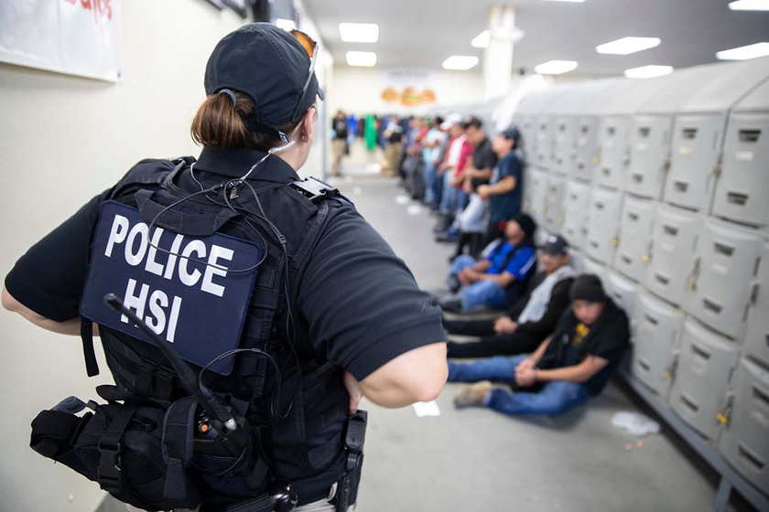
ACLU OF MINNESOTA
IF ICE COMES TO YOUR WORK
ICE must have an arrest or search warrant signed by a judge to enter the building, OR permission from your employer.
If an agent approaches you, ask: “Am I free to go?” If they say no, tell them “I want to remain silent” and calmly walk away.
If ICE uses force, stay calm. Do not interfere or resist.

Slide 16
ACLU OF MINNESOTA
IF ICE COMES TO YOUR WORK
If officers ask to search you, your property or your workspace, state: “I do not consent to a search.” Do not resist if they attempt to search your belongings without your consent.
If safe, write down officers’ names, badge numbers, what they take, or who they arrest. You have the right to take out your phone and record the officers as long as you do not interfere with what they are doing.

Slide 17
ACLU OF MINNESOTA
IF ICE COMES TO YOUR WORK
If officers tell you to line up with others based on your immigration status, you have the right to stay where you are, or you can calmly move to a safe place that is not part of the line. Tell officers “I want to remain silent.” If you are forced to move, do not resist.

Slide 18
ACLU OF MINNESOTA
BE PREPARED
If someone you know is detained by ICE, as soon as possible write down every detail you remember. Include things like times, dates, officers’ names, badge numbers, items they took, individuals they arrested, or any other actions.
If you asserted your rights out loud, make a note of this - especially if officers ignored you.
If you are arrested, do NOT discuss your immigration status with ANYONE—not even other arrested people. Only discuss it with your attorney.
If you are arrested, ask your attorney about how a criminal conviction or plea will affect your immigration status.
Notes:
Cards? Only for family
What's useful for being prepared?
Packet of information showing continuous presence for two years, declarations of their own & family IN THE HOME
"Create a record" 2+y
Make a record after ICE encounter

Slide 19
ACLU OF MINNESOTA
BE PREPARED
Make sure your family has copies of all your immigration documents.
If you have had a continuous presence in the US for over two years, consider creating a packet of information to show this and keep it somewhere secure.
If you have a green card, carry it with you at all times. For all other immigration documents, keep them somewhere secure and carry a copy.
Keep a copy of your immigration documents with someone you trust.

Slide 20
ACLU OF MINNESOTA
BE PREPARED
Talk to an immigration attorney BEFORE you encounter ICE. Memorize your attorney’s name and number.
Consider creating a Power of Attorney and/or DOPAs (Delegations of Parental Authority). A Power of Attorney will allow another adult to act on your behalf legally, and DOPAs will allow another adult to care for your children.
Make sure your family has the following information:
  Your legal name, A# and date of birth.
  Your attorney’s contact information.
  Your union representative or employer’s contact information.
  Contact information for any person named in Powers of Attorney/DOPAs.
  The number of your local ICE field office.
Notes:
Cards? Only for family
What's useful for being prepared?
Packet of information showing continuous presence for two years, declarations of their own & family IN THE HOME
"Create a record" 2+y
Make a record after ICE encounter

Slide 21
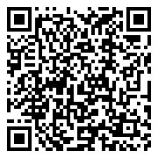

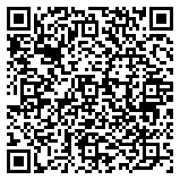
ACLU OF MINNESOTA
BE PREPARED: DOPAS
More info on DOPAs
Do it yourself DOPA

Slide 22
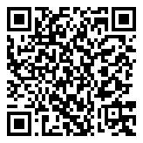

ACLU OF MINNESOTA
POWERS OF ATTORNEY
More info on Powers of Attorney

Slide 23
ACLU OF MINNESOTA
I want to remain silent.
Quiero permanec-er en silencio.
I don’t consent to a search.
No doy mi consenti-miento para una búsqueda.
Am I free to go?
¿Soy libre de irme?
I want to speak to an attorney.
Quiero hablar con un abogado.

Slide 24
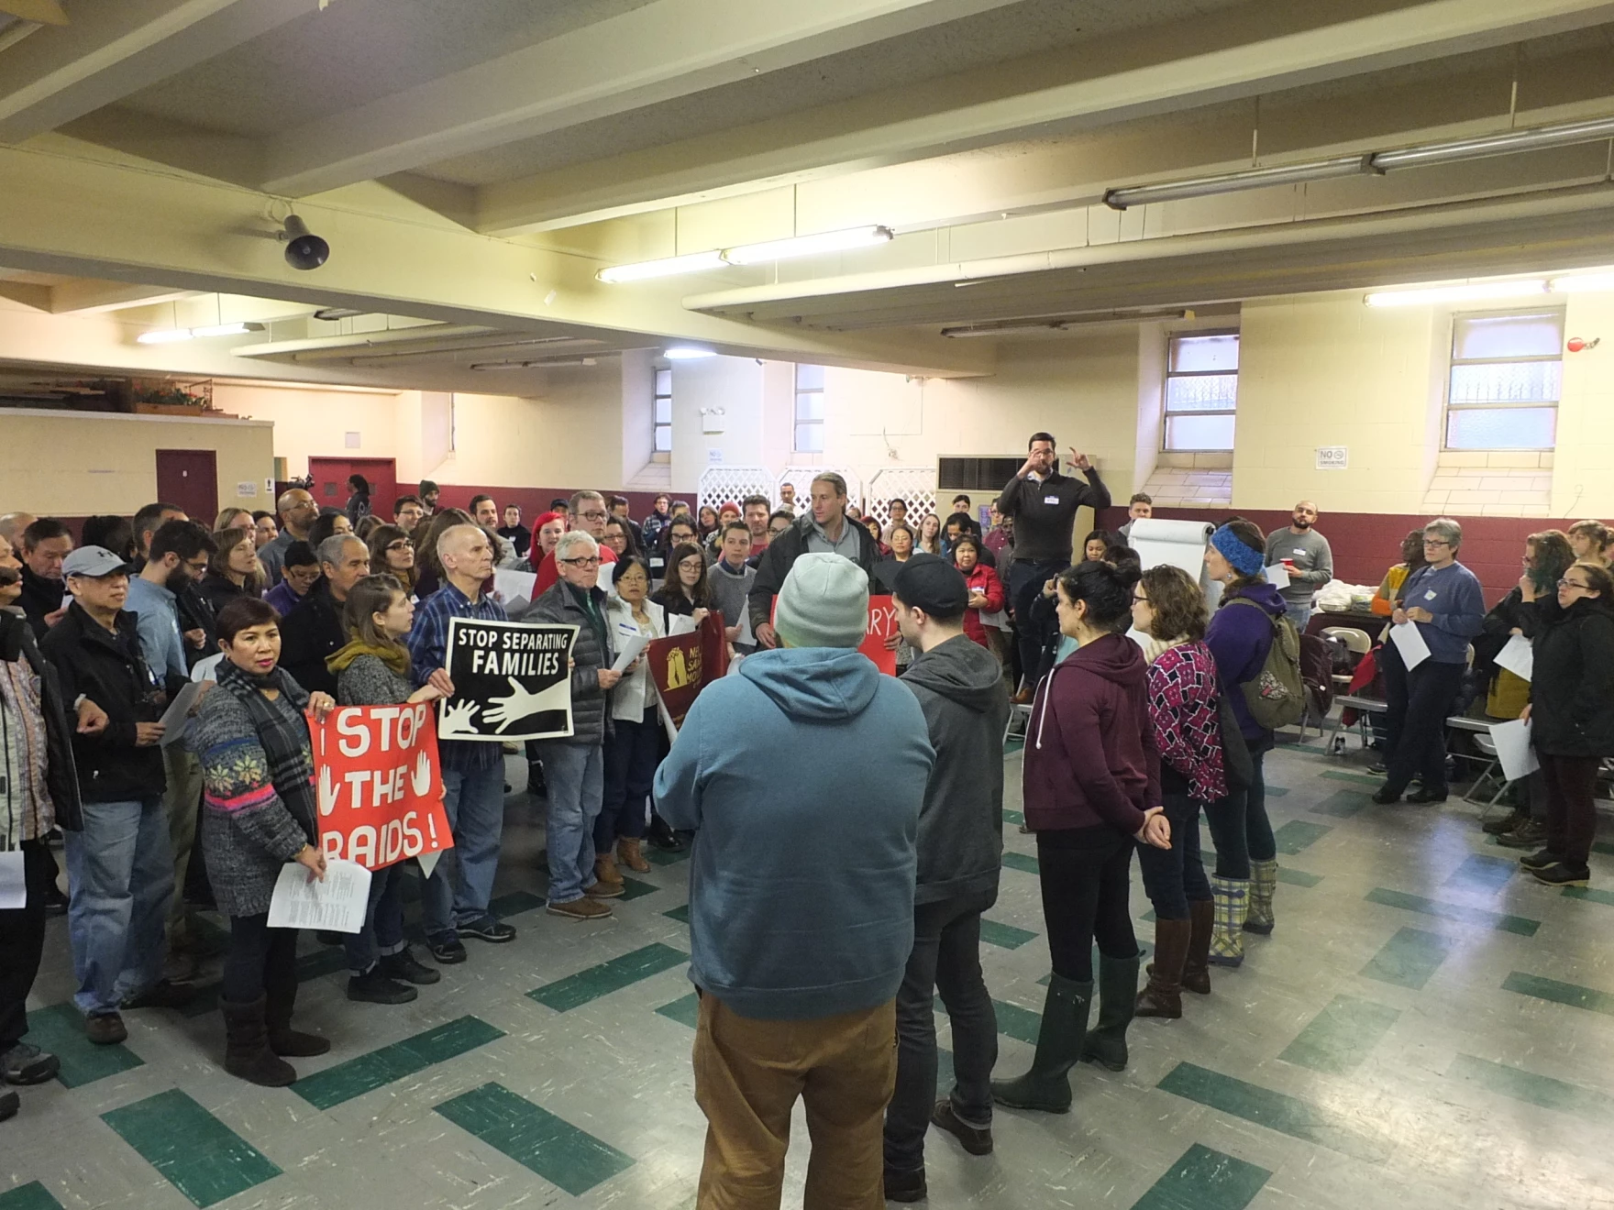
ACLU OF MINNESOTA
ROLEPLAY ACTIVITY

Slide 25

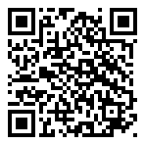
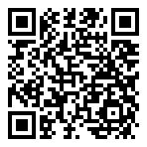
ACLU OF MINNESOTA
KNOW YOUR RIGHTS
REQUEST ASSISTANCE

